Slide 1
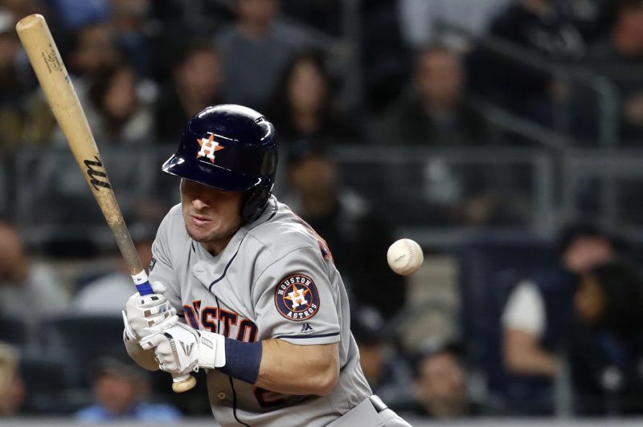

The Open Source Hit By Pitch Database: A Typology
This Photo by Unknown Author is licensed under CC BY-NC
Using unsupervised learning to uncover underlying types of hit-by-pitch events
By Jon Godin

Slide 2
Background / Data Science Problem
Baseball Prospectus:
The Open Source Hit By Pitch Database
Stathead.com’s Baseball
Event Finder has additional
data not in the BP database
Data Science Problem
http://www.baseballprospectus.com/news/article/58297/veteran-presence-the-open-source-hit-by-pitch-database/
Data include every hit-by-pitch occurrence in MLB since 1969
Over 1.8 million cells of data
Opened for research in April 2020
Article author Rob Mains asked for help to “See what you can make of it”
https://stathead.com/tiny/si7Zm
The additional statistics collected by Stathead include:
# of HBPs already in game
Pitch count at time of HBP
Whether an RBI occurred as a result
Win Probability Added (WPA)
Base Out Runs Added (RE24)
Leverage Index (LI)
Problem: Can the 62k+ HBP events be reduced into a typology where all events can be classified as a particular type of HBP?
Approach:
Combine BP’s database with a webscrape of Stathead’s data
Create additional features via feature engineering
Use unsupervised learning to segment or type the data
Then used supervised learning to create a classification algorithm based on the typology

Slide 3
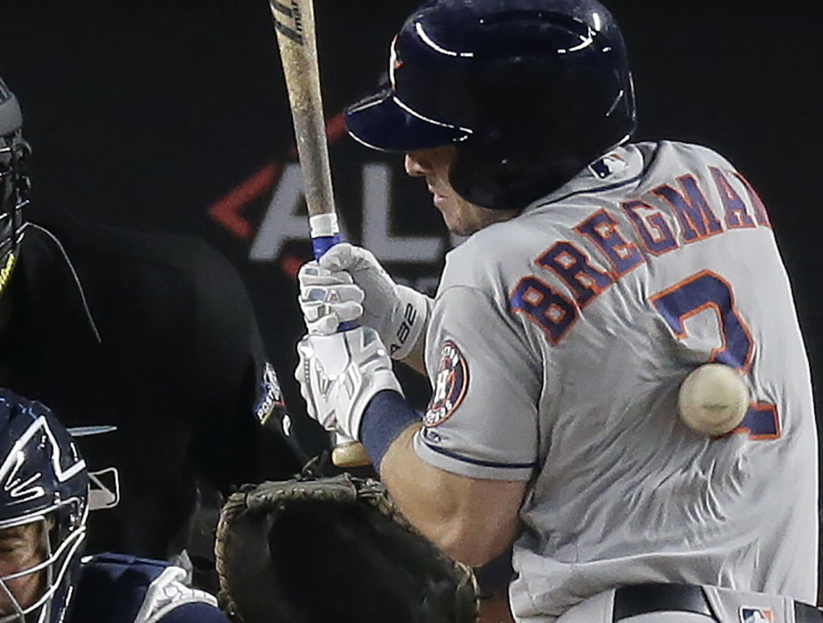
THE DATA

Slide 4
Baseball Prospectus Open Source HBP Database Description of data
FIELD NAME | DESCRIPTION | VALUE DESCRIPTION/RANGE | N Missing
DATE | Date that HBP event occurred | April 7, 1969 – September 29, 2019 | 0
WIN_TEAM | Team that eventually wins the game | Any of the 30 MLB franchises | 0
PIT_ID | Baseball Prospectus Pitcher ID | Numeric code | 0
PITCHER | Pitcher’s name | 4,301 unique pitchers | 0
PIT_TEAM | Pitcher’s team | Any of 30 MLB franchises, 3-letter code used | 0
THROWS | Which arm pitcher throws with (for the at bat) | Left or Right | 0
BAT_ID | Baseball Prospectus Batter ID | Numeric code | 0
BATTER | Batter’s name | 3,969 unique batters | 0
BAT_TEAM | Batter’s team | Any of 30 MLB franchises, 3-letter code used | 0
BATS | Stance of batter (for the at bat) | Left or Right | 0
POSITION | Batter’s field position played at time of at bat | Numeric position code 1 to 11 (10=DH, 11=PH,PR) | 0
LINEUP_SPOT | The batting order position of the batter | 1 thru 9 | 0
BAT_TEAM_SCORE | Number of runs already scored by batting team at time of HBP | 0 to 25 runs | 0
FLD_TEAM_SCORE | Number of runs already scored by pitching team at time of HBP | 0 to 21 runs | 0
BASES_STAT | Number of baserunners on base (and on which base) at time of at-bat | 12 values, from ___ to 123 (empty to full) | 0
HALF | Half inning at time of HBP | Top or Bottom | 0
INNING | Inning at time of HBP | 1 to 22 | 0
OUTS_CT | Number of outs at time of HBP | 0, 1, or 2 | 0
BALLS | Number of called balls at time of HBP – only available from 1988 on | 0, 1, 2, or 3 | 14,104
STRIKES | Number of called strikes at time of HBP – only available from 1988 on | 0, 1, or 2 | 14,104
PITCH_TYPE | Type of pitch thrown that hit batter – only available from 2008 on | 10 pitch types | 42,447
VELOCITY | Velocity of pitch that hit batter – only available from 2008 on | 46.6 mph to 104.4 mph | 42,447
PIT_REMOVED | Whether the pitcher was removed from the game following HBP | Y or N | 0
BAT_REMOVED | Whether the batter was removed from the game following HBP | Y or N | 0
PIT_EJCTECTED | Whether the pitcher was ejected from the game following HBP | Y or N | 0
BAT_EJECTED | Whether the batter was ejected from the game following HBP | Y or N | 0
UMPIRE | Name of umpire during at bat when HBP occurred | 355 unique umpires | 1,124
EJECTIONS_CT | Total number of ejections in game as a result of HBP (may include other players than just batter or pitcher) | 0 to 9 | 0
EJECTIONS_PL | Player names/IDs for all players ejected due to the HBP | Numeric codes | 61,713
EJECTION_DES | Text description of what led to ejections | Text | 61,713
BP’s collection of HBP data includes 62,129 hit-by-pitch events since the start of the 1969 season
The database now includes 30 columns of information after Rob Mains and his team added some additional data at my suggestion (items in red in table)
1,863,870 data points are in the full file
The first version of the database also only had 62,126 rows, as three cases from 1973 were inadvertently missed; I filled these in with information from Stathead’s data in concert with cross-referencing on baseball-reference.com

Slide 5
Stathead.com Baseball Event Finder Description of data
FIELD NAME | DESCRIPTION | VALUE DESCRIPTION/RANGE | N Missing
EVENT_ID | Event # for the range of data selected (Orig. Yr#) | 1 to 62,129 | 0
GAME_STAT | Number of HBP events occurring in game previous to and including this at bat (Orig. Game#) | 1 to 7 | 0
DATE | Date of HBP event | April 7, 1969 – September 29, 2019 | 0
BAT_ID | Baseball Reference ID# for batter | Alphanumeric | 0
BATTER | Batter’s name | 3,969 unique batters | 0
BAT_TEAM | Batter’s team | Any of 30 MLB franchises, 3-letter code used | 0
PIT_ID | Baseball Reference ID# for pitcher | Numeric code | 0
PITCHER | Pitcher’s name | 4,301 unique pitchers | 0
PIT_TEAM | Pitcher’s team | Any of 30 MLB franchises, 3-letter code used | 0
HALF_INNING | Inning (including half) when HBP occurred | t1 to b22 (t=Top, b=Bottom) | 0
ON_BASE | Number of baserunners on base (and on which base) at time of at-bat | 12 values, from ___ to 123 (empty to full) | 0
OUTS | Number of outs at time of HBP | 0, 1, or 2 | 0
PIT_COUNT | Number of pitches thrown by pitcher in this at bat | Includes both total number of pitches plus the count itself (3-2) | 14,429
RBI_ON_PLAY | Whether a run was driven in by batter due to the HBP | 0 (No) or 1 (Yes) | 0
WIN_PROB_ADDED | Given average teams, the change in win probability caused by this batter during the game | -1 to 1 | 0
BASE_OUT_RUNS_ADDED | Given the bases occupied/number of outs situation, how many runs did the batter add in the resulting play. Normalized to per 24 out basis (Orig. RE24) | 0 is average, above 0 is better than average | 0
LEVERAGE_INDEX | The pressure the pitcher or batter saw this at bat. | 1 is average, below 1 is low, above 1 is high | 0
Stathead.com uses data based on play-by-play accounts accumulated by Retrosheet.com.
You can set search criteria for a large number of different baseball events, like HRs, Triples, Sacrifice Bunts, or Hit By Pitches
I included the years 1969 to 2019 in my scrape to match BP’s dataset
Data not included in the BP database are in bold

Slide 6
I also created a database of my own containing franchise information
https://howtheyplay.com/team-sports/major-league-baseball-expansion-and-franchise-relocation
Based on information gleaned from howtheyplay.com, I compiled a database containing information about the team/franchise name, league, and division for each team for each year since 1969.
Several franchises have relocated and/or changed names over the years, and the division alignments have changed a lot as well, going from a two-divisions-per-league structure (East & West) to the current three (East, Central & West). Two teams have switched leagues during that time as well.

Slide 7
Data cleaning & Feature engineering

Slide 8
Data Cleaning: Prior to merge
BP Data
SH Data
Create/combine half and inning variables to match half_inning from Stathead.com (SH hereafter)
Combine the following teams, which relocated or changed names at one point to become current team:
Seattle Pilots (SE1) → Milwaukee Brewers (MIL) in 1970
Washington Senators (WS2) → Texas Rangers (TEX) in 1972
California Angels (CAL) → Anaheim Angels (ANA) in 1997
Montreal Expos (MON) → Washington Nationals (WAS) in 2004
Florida Marlins (FLO) → Miami Marlins (MIA) in 2011
Pitcher and Batter names were not consistently recorded in each database, so prior to merging these needed to be made consistent. For example:
Vangorder → Van Gorder
Decinces → DeCinces
Mccarty → McCarty
Correct runners on base inconsistencies (two instances where SH data was correct and BP data was not)
Make format of DATE variable consistent with BP format
Created doubleheader variable prior to doing so (SH uses (2) after the date to indicate the second game of the day)
Combine franchises and adjust abbreviations to match
KCR → KCA CHC → CHN STL → SLN NYY → NYA
NYM → NYN SFG → SFN SDP → SDN LAD → LAN
SEP → MIL WSA → TEX CAL → ANA MON → WAS
WSN → WAS FLA → MIA TBD → TBA TBR → TBA
LAA → ANA CHW → CHA
Adjust last names of players, including removal of suffixes
Fix game discrepancies
11 HBP events where the game was played in one team’s ballpark, but the other team was designated “home” team because of rescheduling, stadium conflicts, etc. BP data was correct, SH data was not. Confirmed on b-r.com.
# of outs and on-base status matched after 3 cases were added back into BP database

Slide 9
Data Cleaning: Post merge
Removed duplicated columns
Checked missing data
1124 umpire names are missing for some reason; umpire will not be used for any modeling, so these remain
Balls & Strikes were not recorded in the box scores until the 1988 season, so these are missing for any 1969-1987 games
Velocity & Pitch Type were not recorded until PITCHf/x came into being in 2008, so these are missing for any 1969-2007 data
There are also 287 instances of missing velocity data post-2008 for some reason
Because these missing data instances are systematic and due solely to scoresheet practices in a given era, it will be impossible to analyze all 62,129 cases together; data cannot be imputed without gross error, so analysis will need to be done by era
Instead, I created an Epoch variable to characterize each of the three scoresheet epochs
1 = Old School Scoresheets (no balls & strikes, no velocities or pitch types) – 1969-1987 – 14,104 HBP events
2 = Project Scoresheet Era (balls & strikes begin to be recorded, but not velocities or pitch types) – 1988-2007 – 28,056 HBP events
3 = PITCHf/x Era (all balls & strikes are recorded, along with velocities and pitch types) – 2008-2019 – 19,969 HBP events
Fixed the Pat Verditte Problem
Pat Verditte is the only pitcher in the database to be designated as a “switch pitcher”, meaning he can pitch with either his left or right arm
For the batters in the database, any switch hitters were not called out as such, they were recorded based on the side of the plate they were batting from (i.e., right-handed or left-handed batting stance)
Research showed that Verditte almost always pitched with the same handedness as the batter was batting, so the “S” designation in the database was adjusted to R or L for each of Verditte’s HBP events

Slide 10
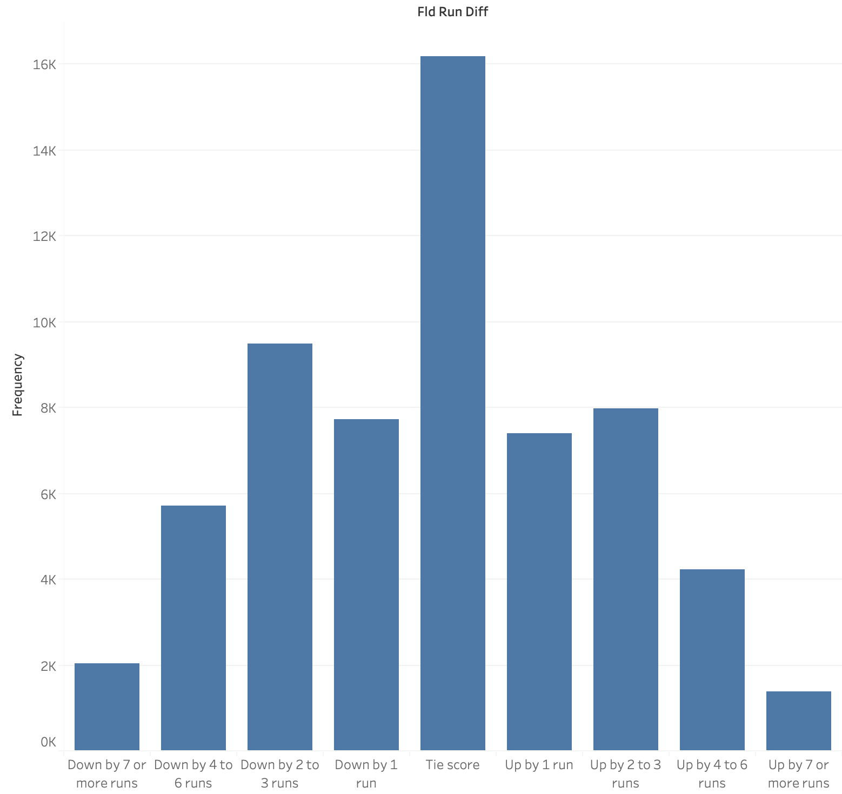
A number of features were created or modified from the original data
Combined low-frequency pitch types
Slow Curves (CS) were designated as Curves (CU)
Screwballs (SB) were designated as Sliders (SL)
Extra-inning games are rare, so any inning beyond the 10th was designated with a 10
Count status and pitch variable missing data indicators were created
Created a “PIT_BAT” variable to combine who the pitcher and batters were for each event for easier EDA
Recoded winning team variable so it was relative to the pitcher (and not based on team name alone)
In earlier eras, tie games actually happened, so also created a Tie Game indicator
Indicator showing whether pitching team was home team was added
SH data originally had the number of pitches and the count in a single field [“11 (3-2)”], so the number of pitches were split into its own variable
Computed a run differential variable relative to the fielding team
Most games don’t have large run differentials, as you can see here
So, I also created a categorized version which runs from “Down by 7+ runs” to “Up by 7+ runs”

Slide 11
Feature engineering, continued
Using the information gleaned from howtheyplay.com, new variables were created based on league and division information
PIT_LEAGUE / BAT_LEAGUE
PIT_DIVISION / BAT_DIVISION
PIT_LEAGUE_DIVISION / BAT_LEAGUE_DIVISION
Based on these new variables, I created a new GAME_TYPE variable to indicate the nature of each game:
“Division” – games between teams in the same division
“Intraleague” – games between teams in the same league, but not the same division
“Interleague” – games between teams in different leagues, regardless of division
Ejection & removal variables were converted from Y/N to 1/0 variables
An “any ejection” indicator was created, equaling 1 if the ejections count was > 0, otherwise equaling 0
Batter (field) positions were slightly adjusted
PH (=11) and PR (=0) fields were combined into PH_PR
Values were simultaneously converted into their string equivalents for easier interpretation (e.g., 1=P, 2=C, …, 10=DH, 11=PH_PR)
Created a POSITION_GROUP variable which grouped batter (field) positions into four categories:
Infielders
Outfielders
Pitchers & Catchers
Designated Hitters, Pinch Hitters, and Pinch Runners
Grouped velocity two ways:
Low/Avg/High binaries
Categorical ranges:
Under 70 mph
70-79 mph
80-89 mph
90-95 mph
96+ mph

Slide 12
Features not further engineered
Because Win Probability Added (WPA), Base Out Runs Added (RE24), and Leverage Index (LI) are relatively well-known in the sabermetrics community, I decided not to further recode or bucket these variables
WPA and LI have tight distributions with narrow ranges for the most part, though a large number of statistical outlier cases are evident in the box-and-whisker plots to the left

Slide 13
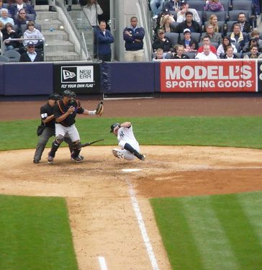
Exploratory Data analysis
This Photo by Unknown Author is licensed under CC BY

Slide 14
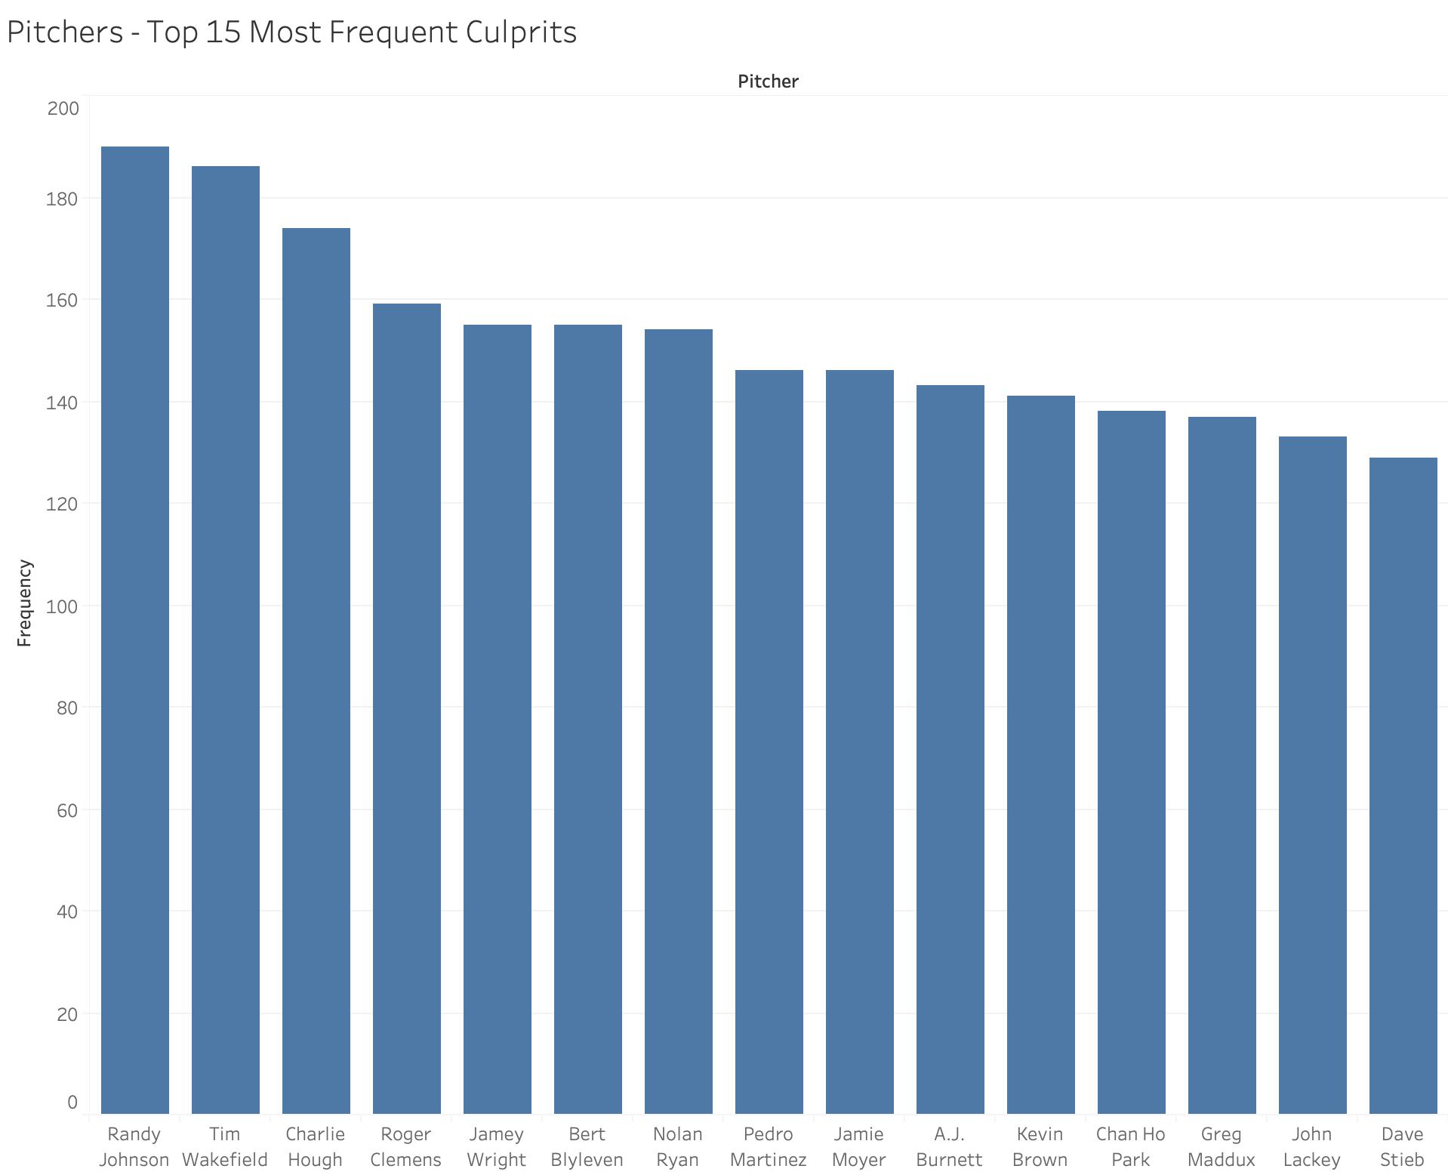
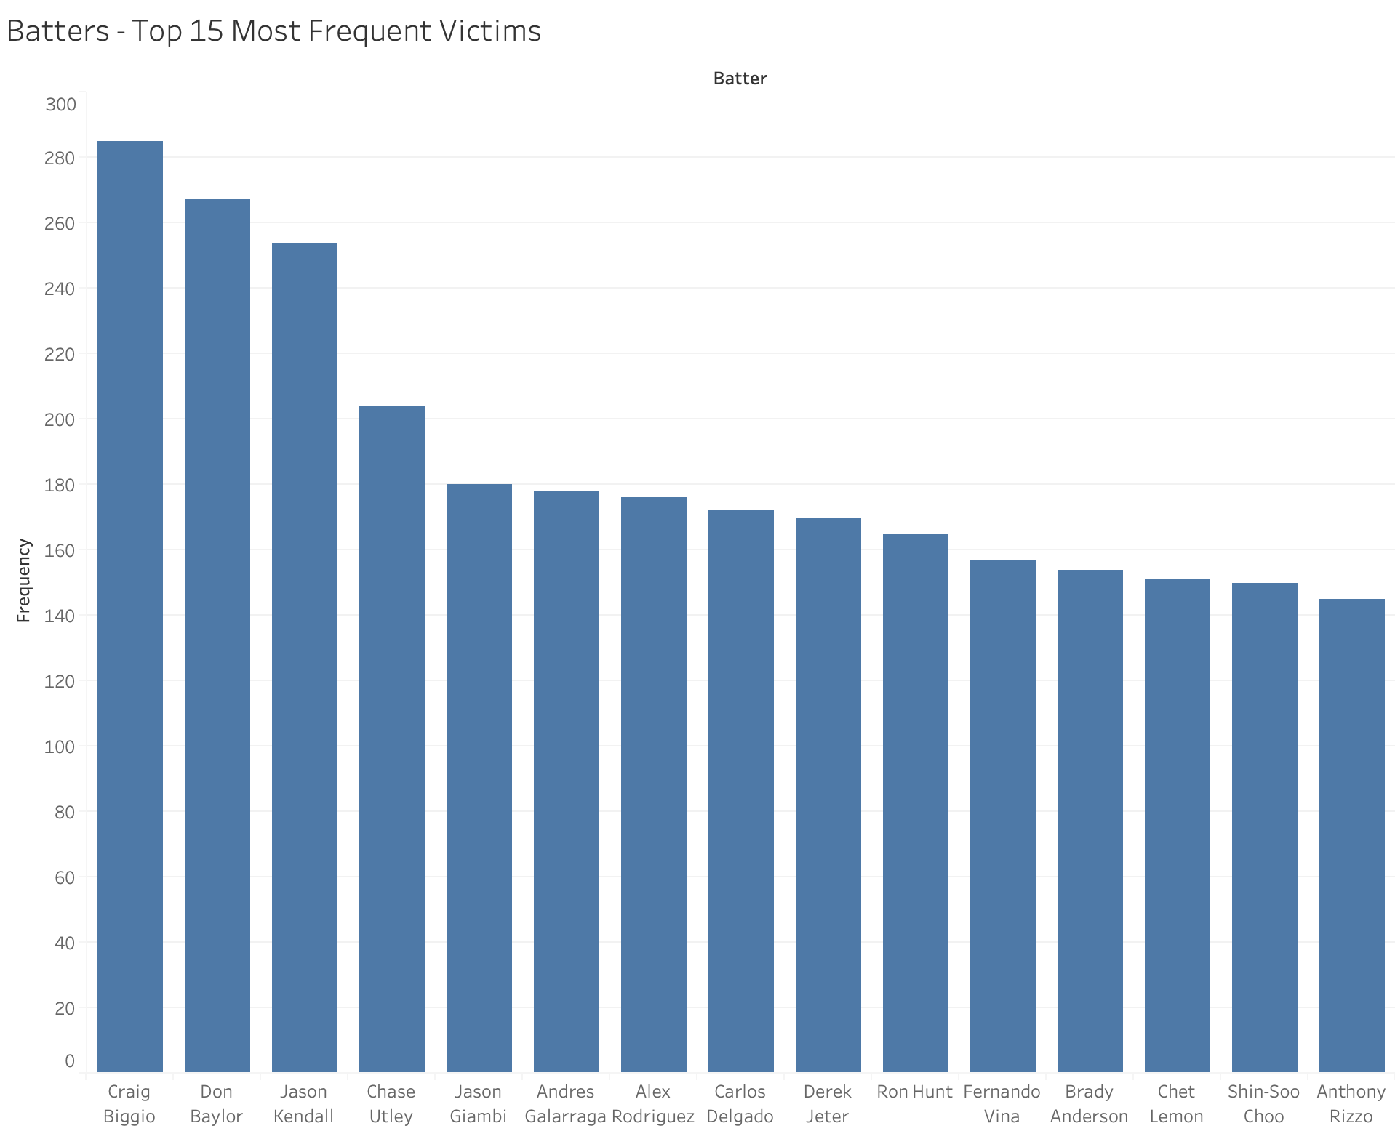
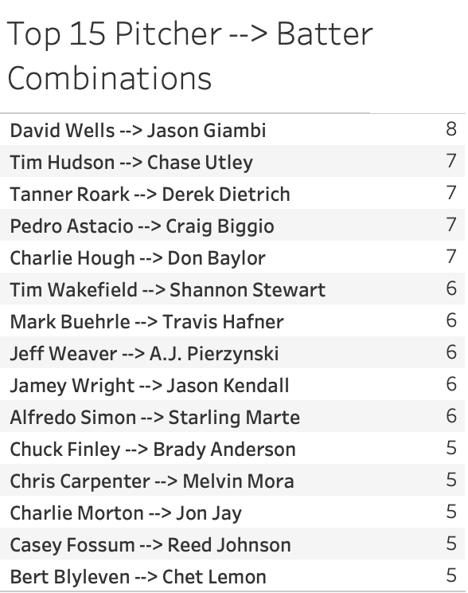
Worst Culprits / Victims of Hit By Pitches – Overall

Slide 15
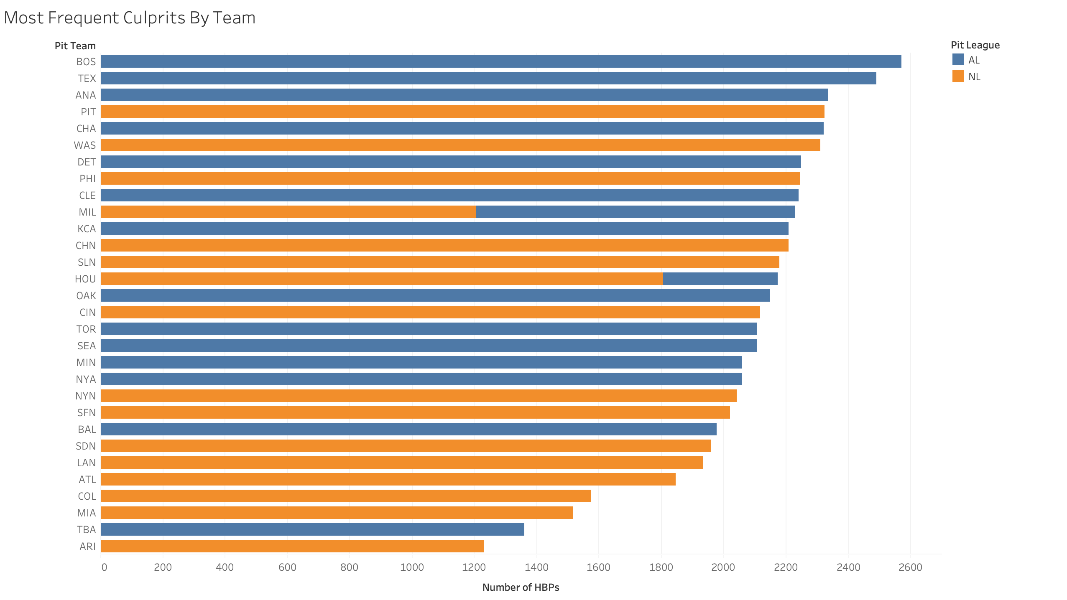
Most Frequent Team Combos? Red Sox Pitchers Hitting Yankee Batters!

Slide 16
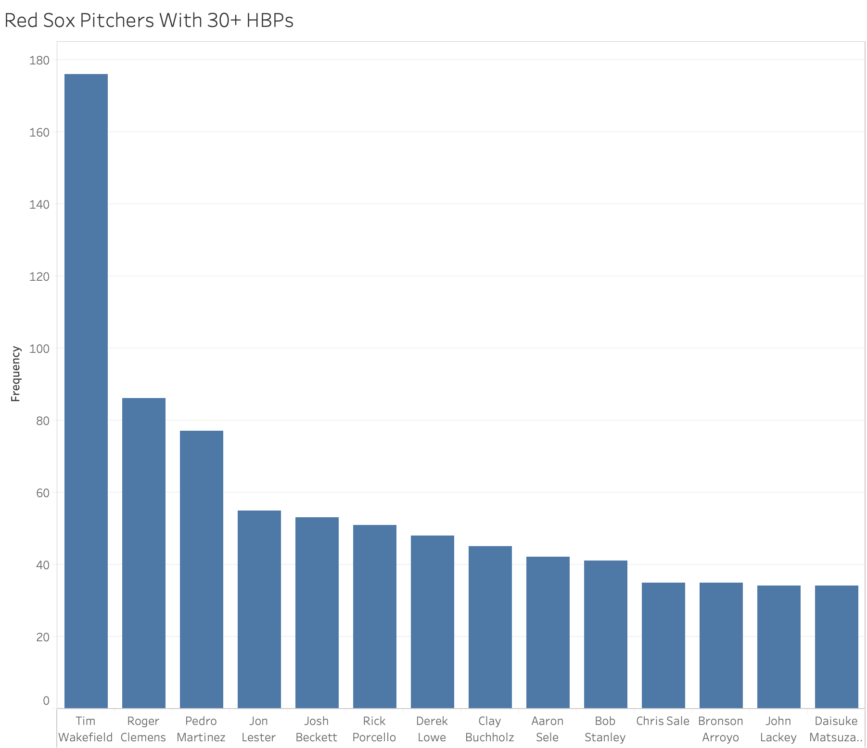
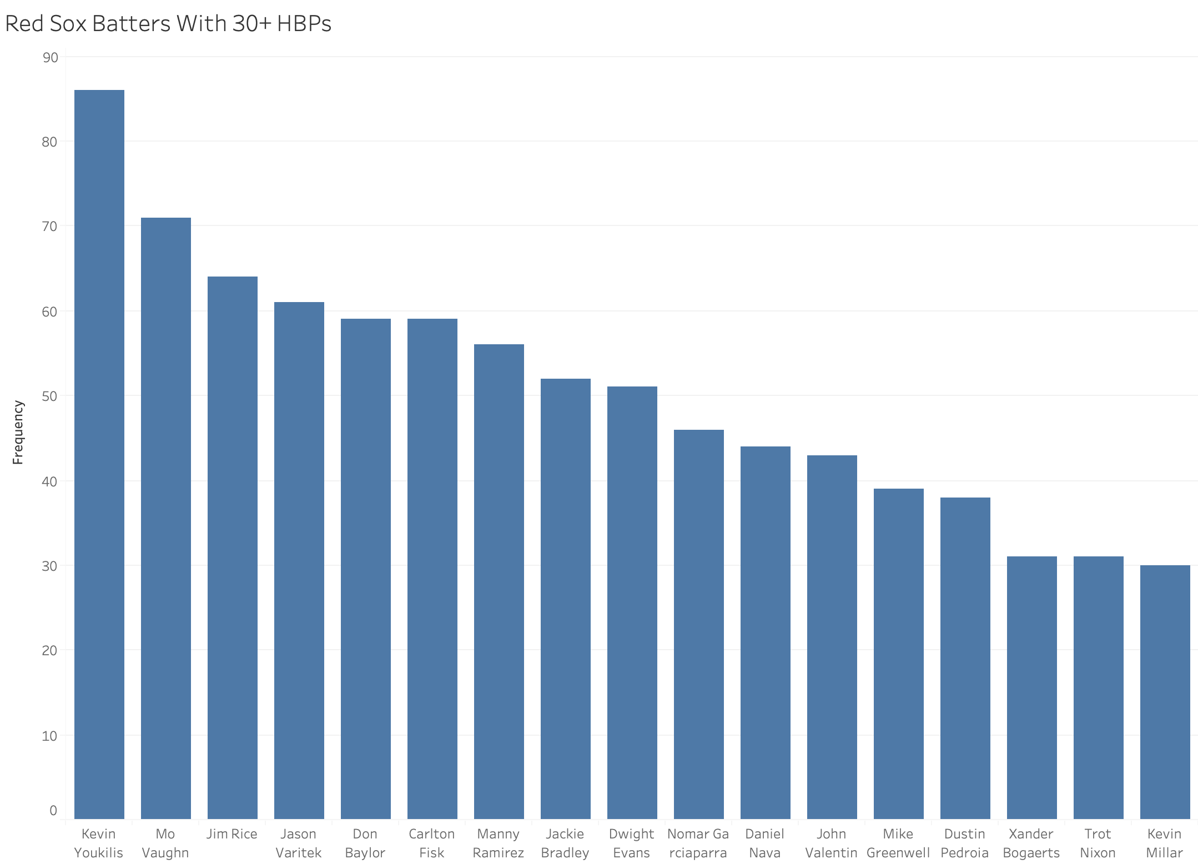
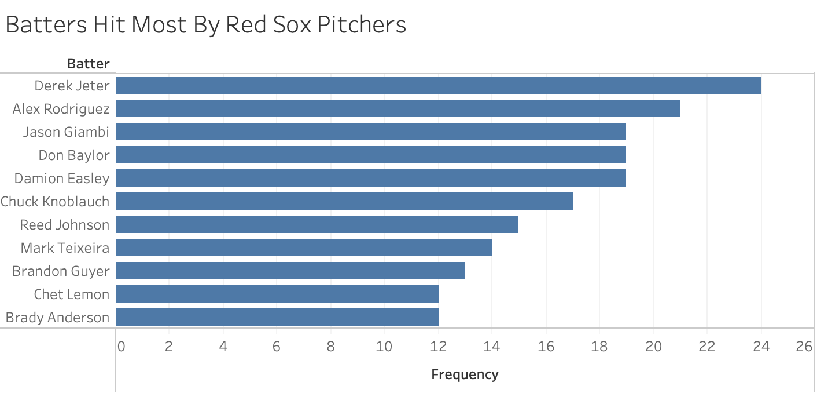
About those Red Sox…

Slide 17
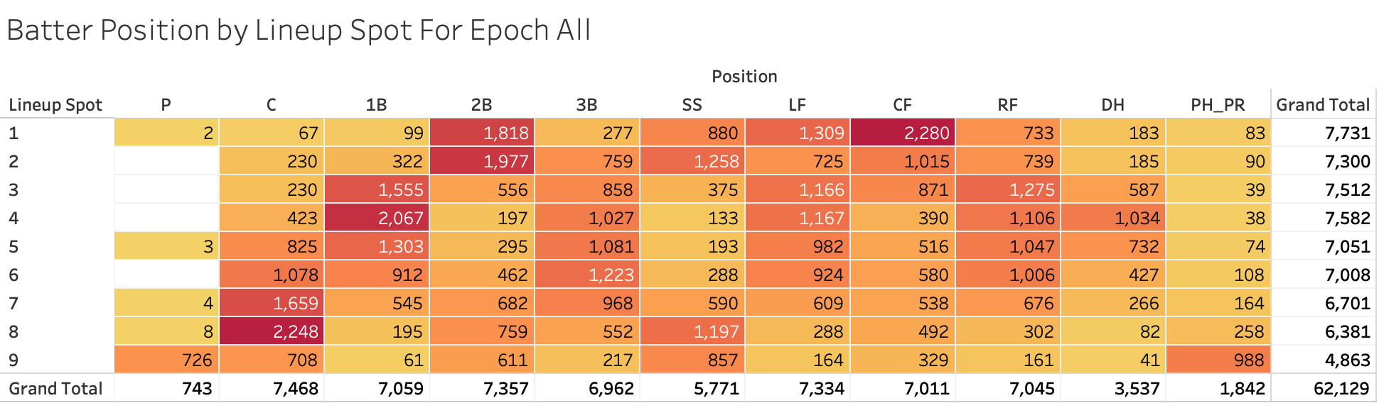
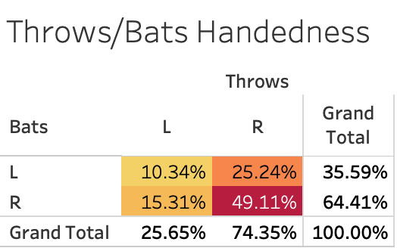
Lineup spots, Positions, and Handedness
Leadoff hitters get hit the most frequently overall, with centerfielders batting leadoff having the highest frequency of HBPs overall.
However, by position alone, catchers are the most frequently hit by pitches, and among primary position players, shortstops are least hit.
In terms of handedness, there are only slightly higher incidences of Lefty-Lefty and Righty-Righty HBPs than expected (9% and 48%, respectively)

Slide 18
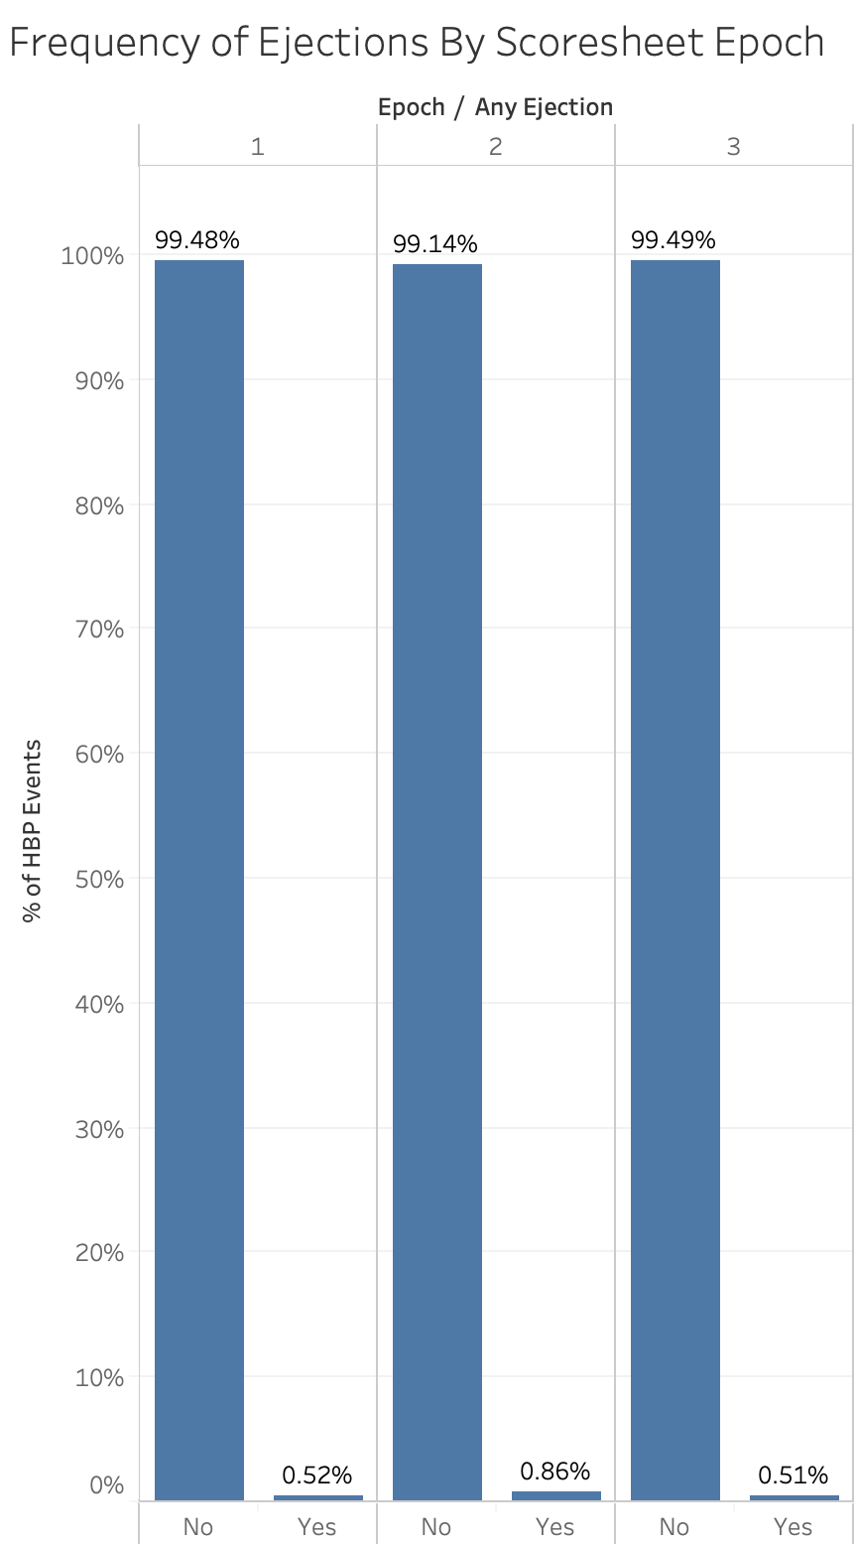
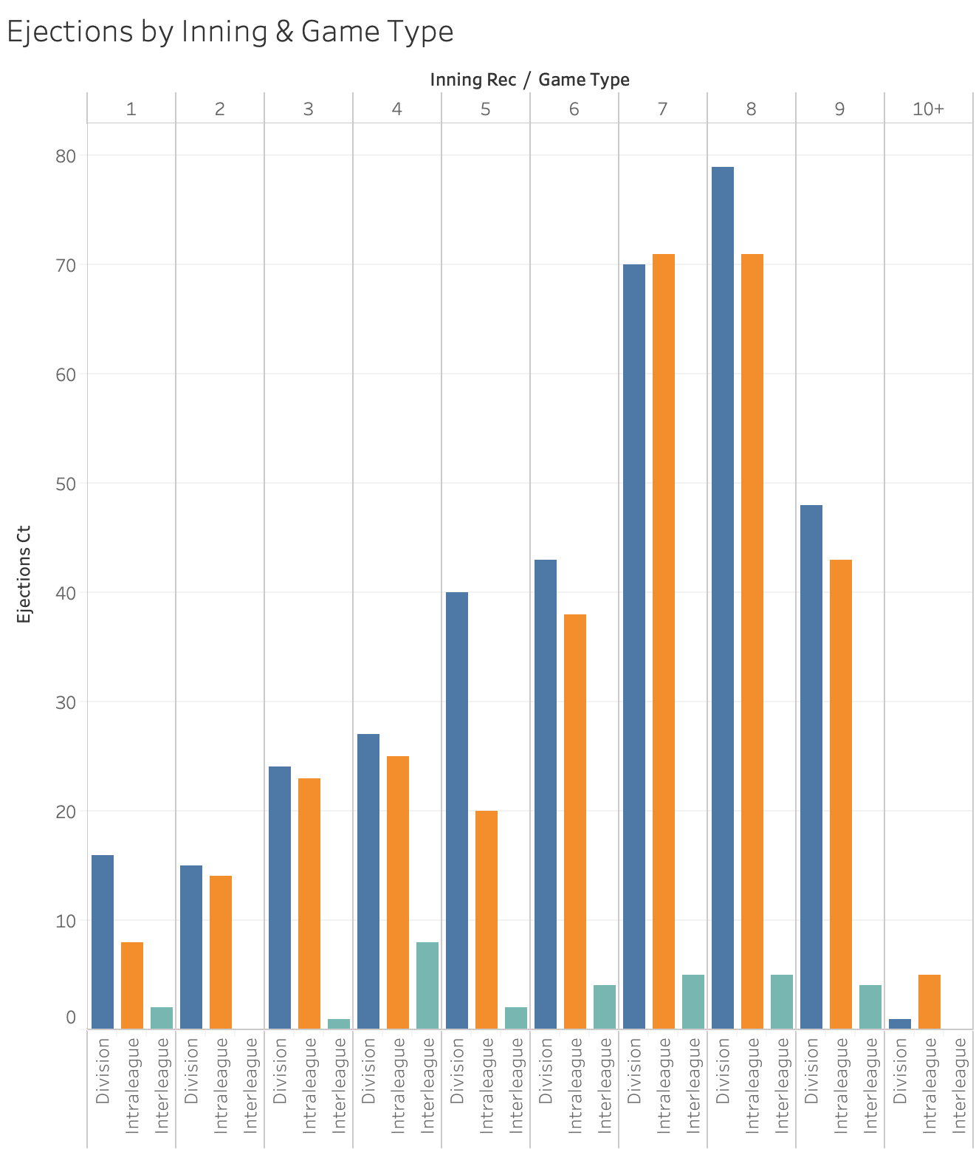
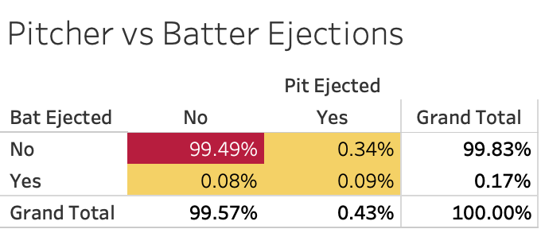
I only came here for the ejections, but they’re quite rare (0.67% of HBPs)
Ejections tend to be more frequent in the 7th-9th innings for Division and Intraleague games
FAVORITE DESCRIPTION
There had been threatening pitches in the game one day earlier; the first pitch in this inning hit Dwight Gooden on the knee; Gooden, who had already hit two Phillies earlier in the game, took off his helmet and charged the mound; he was tackled and repeatedly punched by Phillies catcher Darren Daulton; a 20-minute melee erupted; 2B umpire Joe West threw Phillies pitcher Dennis Cook to the ground and HP umpire Randy Marsh considered asking for help from the police; Phillies ejections: Pat Combs, Dennis Cook, Darren Daulton, coach Mike Ryan; Mets ejections: Dwight Gooden, Darryl Strawberry, Tim Teufel; all ejections by Marsh

Slide 19
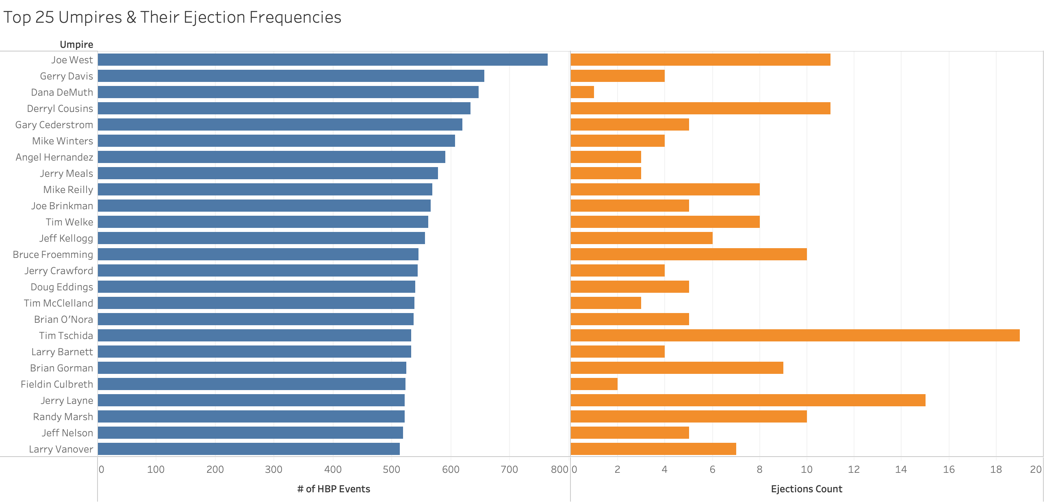
Some umpires were more likely to throw out players than others

Slide 20
Visualizations only relevant for Epoch 3 (PITCHf/x Era)

Slide 21
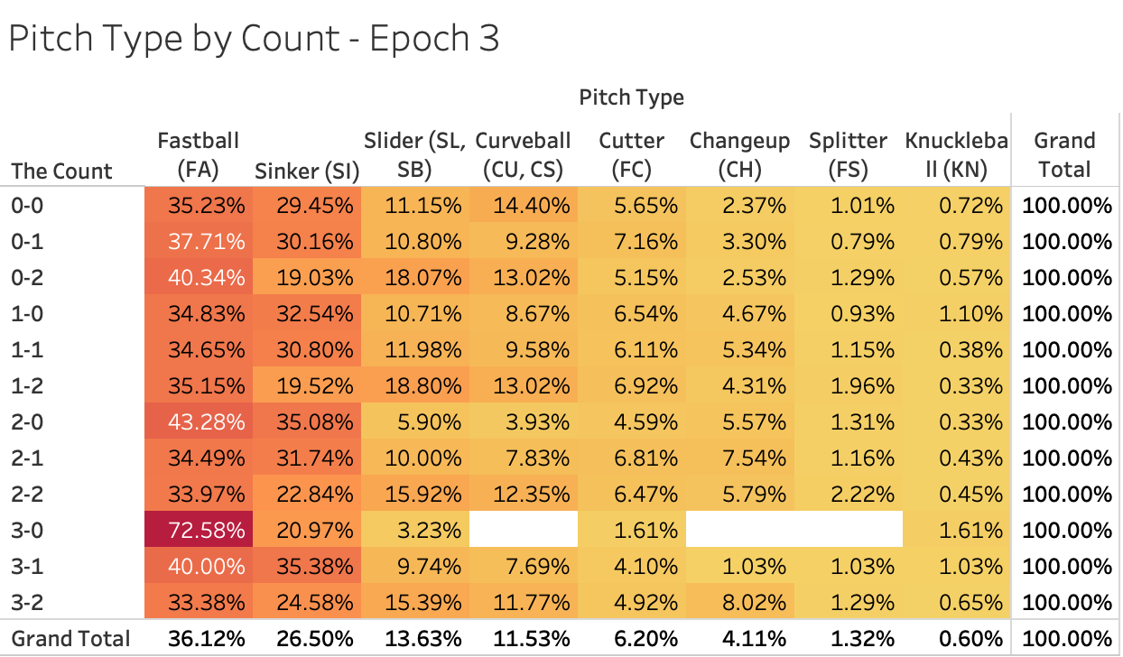
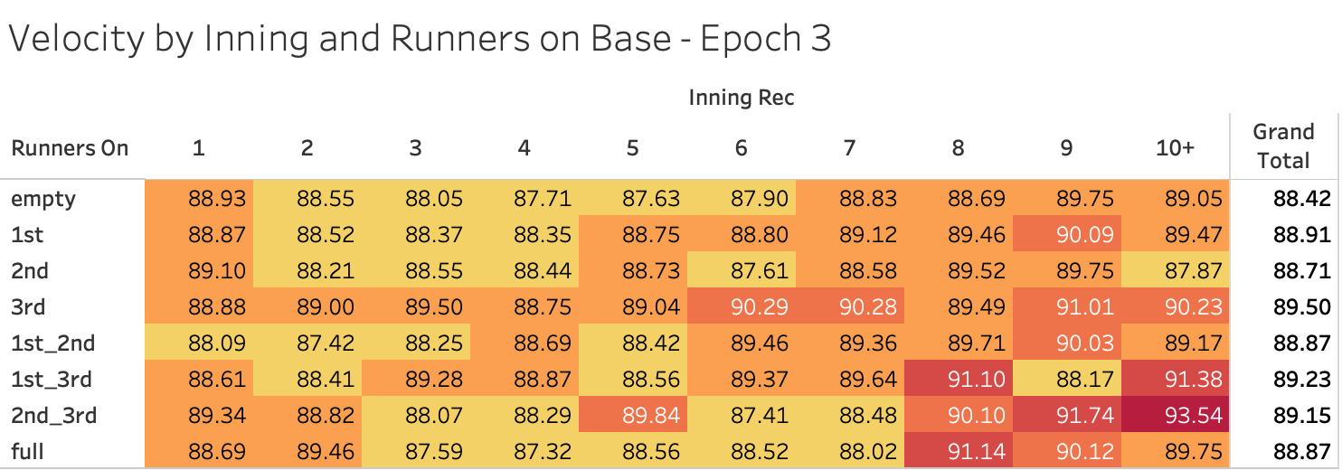
HBPs from Fastballs occur more frequently in hitters’ counts; In late-and-dangerous situations, pitchers tend to turn up the heat

Slide 22
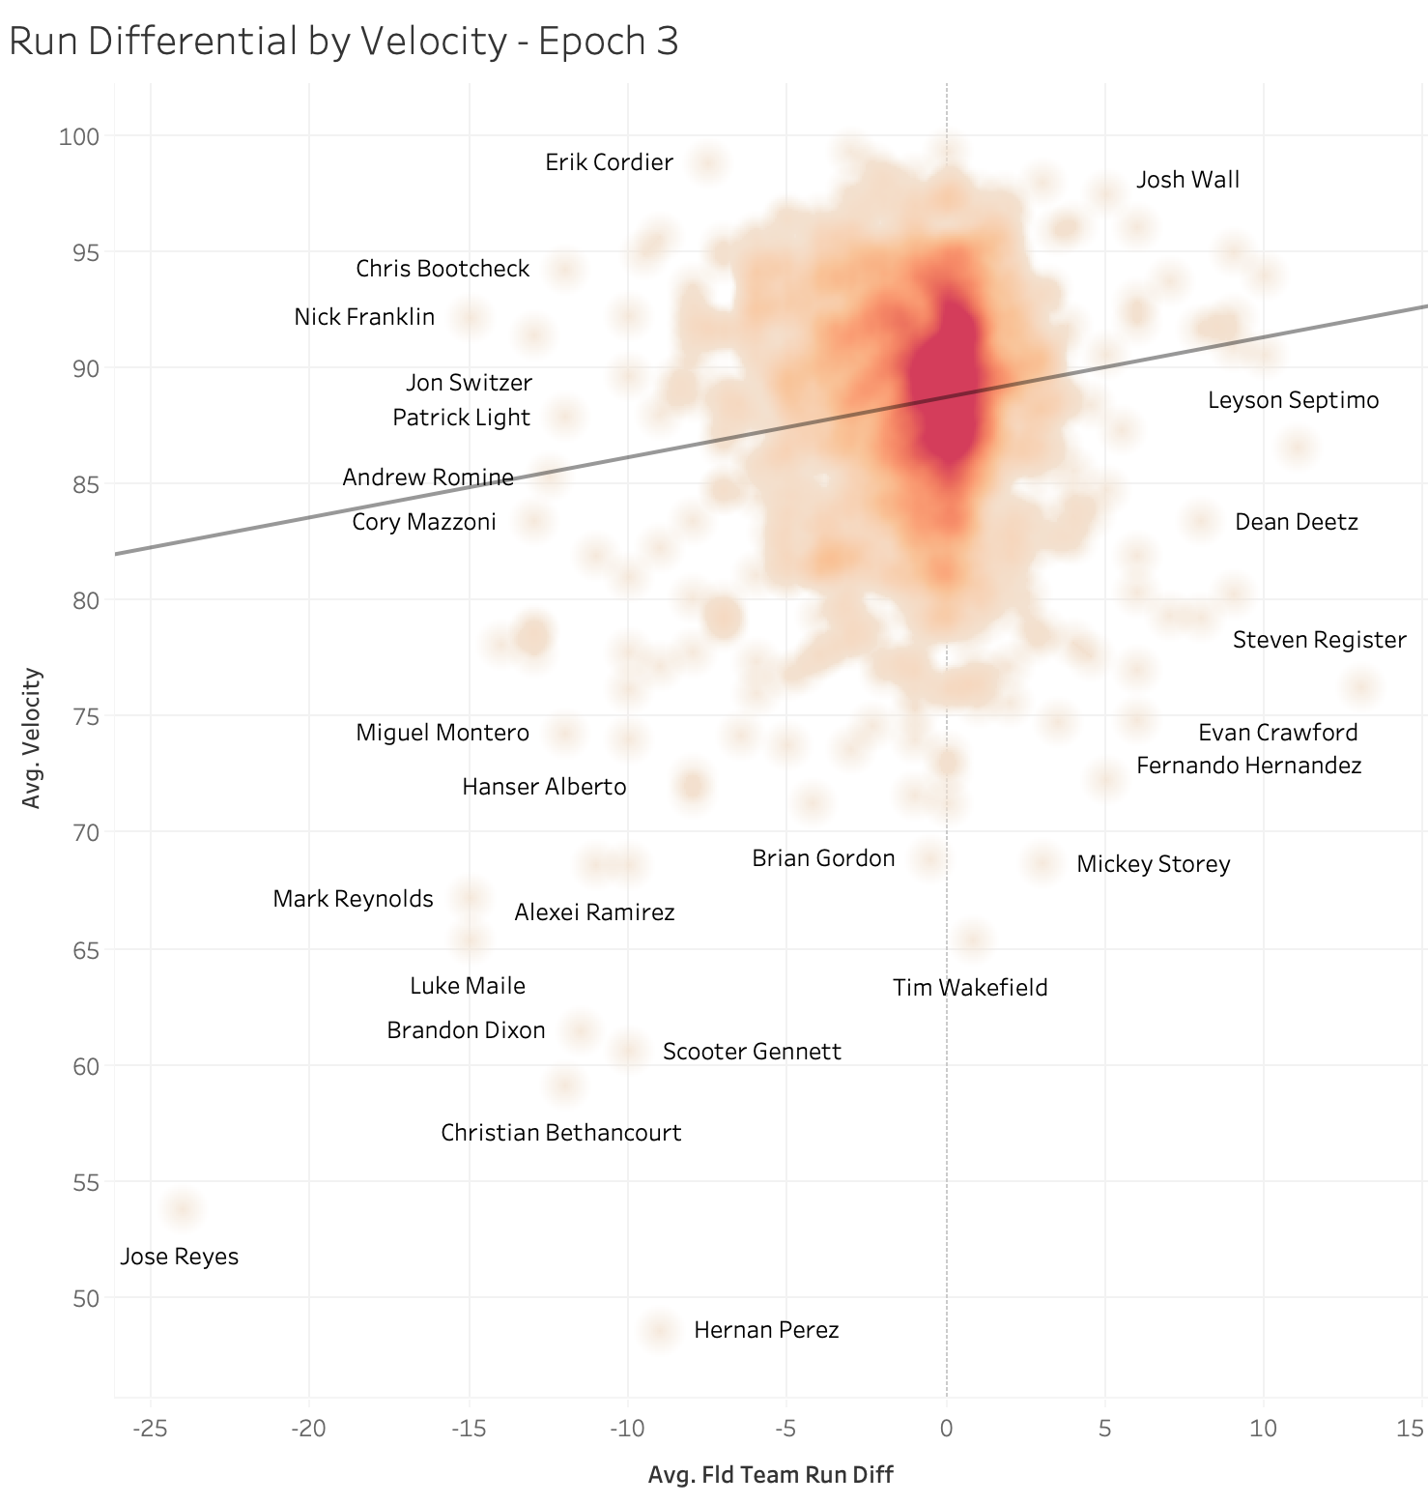
Note that not all Fastballs are necessarily all that fast…
These outliers are most likely position players who are asked to pitch in the late innings of blowout games – they throw fastballs since they probably don’t have a real pitch repertoire, but they don’t necessarily have comparable Big League heat either

Slide 23
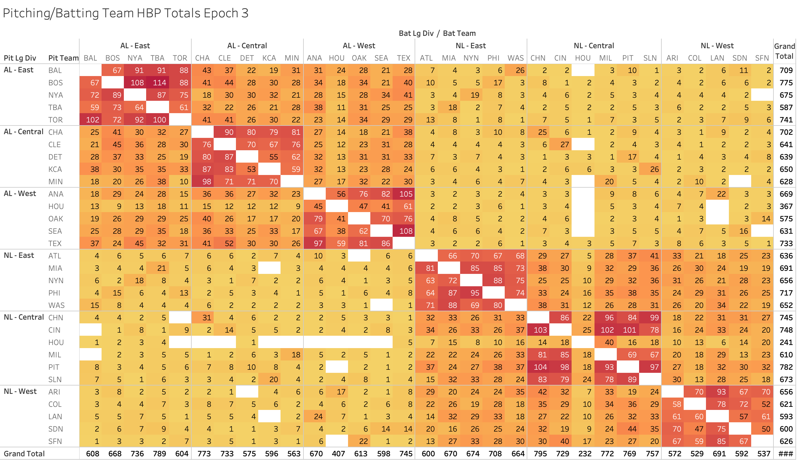
In Epoch 3, PIT has hit the most batters, but BOS→TBA is most frequent
The Chicago Cubs have been hit the most in this era with 795
Tampa Bay leads all AL teams with 789

Slide 24
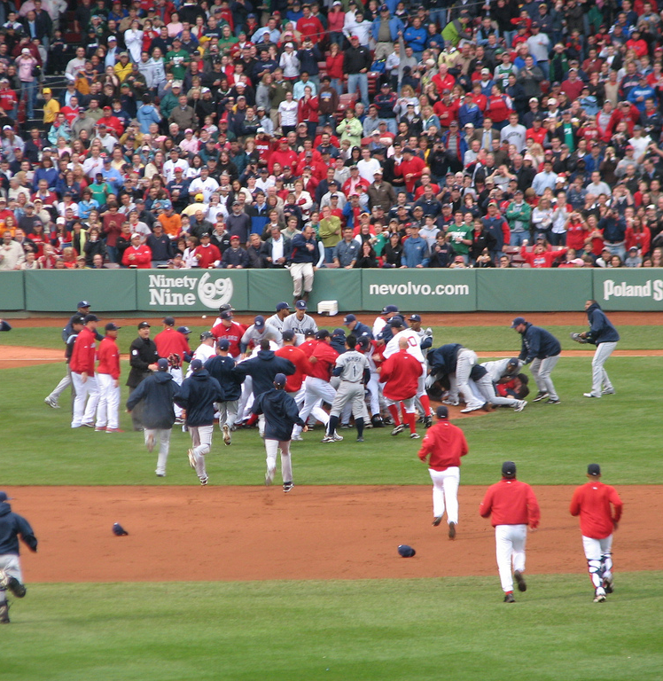
Machine Learning models
Unsupervised and Supervised approaches to better understand the HBP data
This Photo by Unknown Author is licensed under CC BY-SA

Slide 25
Before starting to model
Several considerations needed to be dealt with
Categorical Predictors Must Be Converted to Binary
Split Data By Epoch to
Deal With Missing Values
Predictors Have Mixed Data Types: What to Do?
Most if not all unsupervised learning models in Python cannot read data values in string form
Categorical and numeric variables not intended to be used as such (like Month) thus need to be either one-hot encoded or dummified by using Pandas get_dummies method
Final list of potential X variables includes 114 measures
Since we have systematic missing pitch information in Epochs 1 & 2 (and even a little in Epoch 3), all data cannot be analyzed at once
Again, most unsupervised models were not designed to handle missing data, and these variables cannot be imputed with any hope of accuracy
So, due to time limitations, I chose to only analyze Epoch 3 for this presentation
Most if not all sklearn unsupervised learning models depend on having true numeric (and not binary) data so metric distances can be calculated
The HBP data contains a mixture of many binary categorical variables along with a few true numeric features like velocity
This severely limits the choice of models to try in order to solve the data science problem

Slide 26
List of potential clustering variables - continuous in red
month_3
month_4
month_5
month_6
month_7
month_8
month_9
month_10
doubleheader
pit_team_is_home
game_type_Division
game_type_Interleague
game_type_Intraleague
game_stat
throws_L
bats_L
position_1B
position_2B
position_3B
position_C
position_CF
position_DH
position_LF
position_P
position_PH_PR
position_RF
position_SS
position_group_DH_PH_PR
position_group_Infielder
position_group_Outfielder
position_group_Pitcher_Catcher
lineup_spot_1
lineup_spot_2
lineup_spot_3
lineup_spot_4
lineup_spot_5
lineup_spot_6
lineup_spot_7
lineup_spot_8
lineup_spot_9
fld_run_diff_Down by 1 run'
fld_run_diff_Down by 2 to 3 runs
fld_run_diff_Down by 4 to 6 runs
fld_run_diff_Down by 7 or more runs
fld_run_diff_Tie score
fld_run_diff_Up by 1 run
fld_run_diff_Up by 2 to 3 runs
fld_run_diff_Up by 4 to 6 runs
fld_run_diff_Up by 7 or more runs
pit_team_is_ahead
pit_team_is_behind
runners_on_1st
runners_on_1st_2nd
runners_on_1st_3rd
runners_on_2nd
runners_on_2nd_3rd
runners_on_3rd
runners_on_empty
runners_on_full
risp
half_Top
inning_rec_1
inning_rec_2
inning_rec_3
inning_rec_4
inning_rec_5
inning_rec_6
inning_rec_7
inning_rec_8
inning_rec_9
inning_rec_10
outs_ct
num_pitches
the_count_0-0
the_count_0-1
the_count_0-2
the_count_1-0
the_count_1-1
the_count_1-2
the_count_2-0
the_count_2-1
the_count_2-2
the_count_3-0
the_count_3-1
the_count_3-2
pitch_type_Changeup (CH)
pitch_type_Curveball (CU, CS)
pitch_type_Cutter (FC)
pitch_type_Fastball (FA)
pitch_type_Knuckleball (KN)
pitch_type_Sinker (SI)
pitch_type_Slider (SL, SB)
pitch_type_Splitter (FS)
Velocity
low_velocity
avg_velocity
high_velocity
velocity_range_70-79 mph
velocity_range_80-89 mph
velocity_range_90-95 mph
velocity_range_96+ mph
velocity_range_Under 70 mph
velocity_range_Unknown
rbi_on_play
win_prob_added
base_out_runs_added
leverage_index
winning_team_Team pitching
pit_removed
bat_removed
pit_ejected
bat_ejected
any_ejection
ejections_ct

Slide 27





Modeling included several steps
Some worked quite well, others didn’t produce very useful results
Unsupervised Learning
(to attempt to uncover any underlying classes in the data)
Supervised Learning
(to predict classes from unsupervised learning)
HDBSCAN modeling
K-prototypes modeling
PCA (visualization)
LDA classification
Xgboost classification
New-ish hierarchical version of DBSCAN model
Used custom distance metric called HEOM to deal with mixed data types among X variables
Alternative version of k-means model using a different distance metric that better handles mixed data types
Since there is very high dimensionality in the data, I tried using PCA to visualize segment differences
Linear Discriminant Analysis can be used for dimension reduction like PCA, but it also works as a decent classifier frequently used in business for its simplicity
Very powerful and fast implementation of a gradient boosting classifier in this case; great benefit is its ability to handle missing data, along with usual high performance

Slide 28
Unsupervised Learning Attempt #1: HDBSCAN with HEOM Distances
HDBSCAN was developed by a group of academics in order to produce better-behaving DBSCAN models – see YouTube for a great introductory video
HDBSCAN is implemented to work with any distance metric in scikit-learn, but can also use a custom distance metric
Since we have mixed data, standard distance metrics aren’t an option
Enter Heterogeneous Euclidean-Overlap Metric (HEOM), included in a Python package called distython, created by a graduate student named Kacper Kubara
HEOM distances are computed as follows:
If categorical – returns 0 if the attribute is of the same class, 1 otherwise
If numerical, computes the distance using the normalized Euclidean distance metric (so no additional scaling is required)
If missing, returns 1
Final result is the square root of the sum of every distance squared
As with DBSCAN, HDBSCAN does not attempt to classify every case whether it is warranted or not
Any cases not surrounded by enough density in multidimensional space are considered noise by the model, and classified as -1
HDBSCAN extends DBSCAN by converting it into a hierarchical clustering algorithm, then using a technique to extract a flat clustering based on the stability of the clusters - see https://hdbscan.readthedocs.io/en/latest/how_hdbscan_works.html for more detail
Upshot – this is a really interesting approach, but if you have noisy data, it may end up classifying most observations as noise, which isn’t that helpful when trying to make inferences about a dataset

Slide 29
HDBSCAN + HEOM Results
Condensed Tree Plot
Unfortunately, this was a case where the model had trouble finding a strong enough signal in the midst of all of the noise
Initial model found 13 clusters in the data (including Noise, which isn’t a true cluster)
However, 88.6% of cases were labeled as being Noise, one cluster had 10.8% of cases, and the remaining clusters uncovered were therefore quite miniscule
The charts to the left show this, with one initial giant yellow bar representing the noise and not much pulled out beyond that
Additional model tunings were attempted (including switching from the eom cluster selection method to the leaf method, and adjusting the min cluster size and min samples hyperparameters), but an acceptable solution was not found
Best had 8 groupings including noise (94%), 3 clusters > 1% and remaning clusters >= 0.5%
Single Linkage Tree

Slide 30
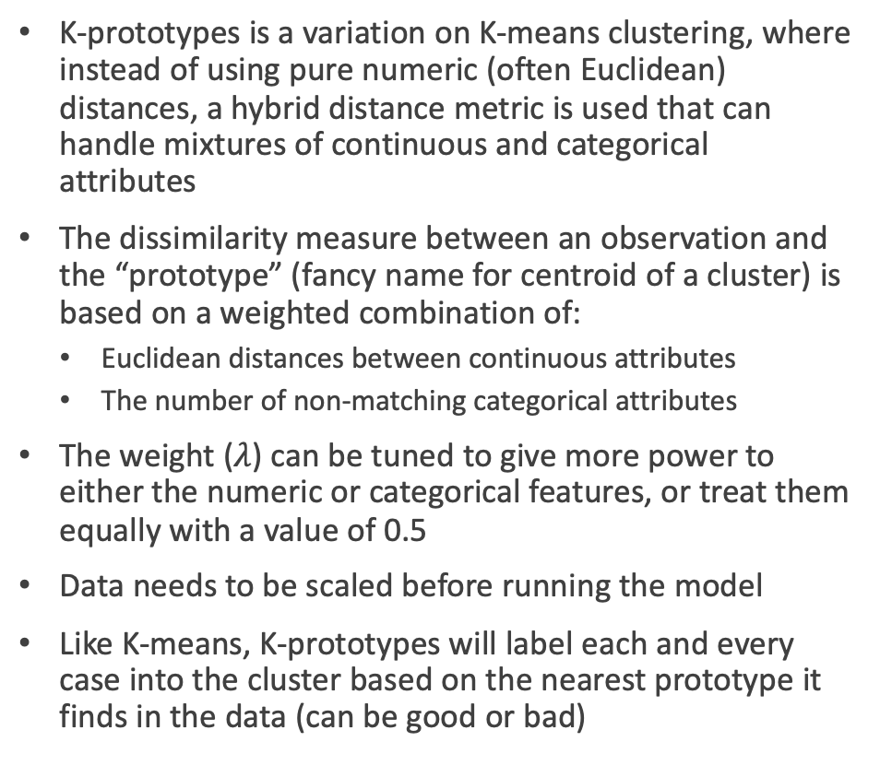
Unsupervised Learning Attempt #2: K-Prototypes Version 1
K-prototypes is a variation on K-means clustering, where instead of using pure numeric (often Euclidean) distances, a hybrid distance metric is used that can handle mixtures of continuous and categorical attributes
The dissimilarity measure between an observation and the “prototype” (fancy name for centroid of a cluster) is based on a weighted combination of:
Euclidean distances between continuous attributes
The number of non-matching categorical attributes
The weight ($λ$) can be tuned to give more power to either the numeric or categorical features, or treat them equally with a value of 0.5
Data needs to be scaled before running the model
Like K-means, K-prototypes will label each and every case into the cluster based on the nearest prototype it finds in the data (can be good or bad)
Also like K-means, K-prototypes depends on the data scientist telling the learner how many prototypes to find, and in the real world (unlike with simulated data) there is no known truth here
So, a common approach is to use different randomized starting points for a range of different numbers of clusters
A pseudo grid search can be constructed to accomplish this task
The resulting solutions can be compared based on the model cost (think reproducibility) and silhouette score metrics
A typical approach is to look for “elbows” in the cost plot – where an elbow exists is considered to be a reasonable solution, which hopefully corresponds with a higher silhouette score
For Version 1 of K-prototypes, the 287 missing velocities in Epoch 3 were set to 0 so they could be included

Slide 31
K-prototypes Version 1 Results
A series of solutions were run, ranging from 2 to 14 clusters – resulting diagnostic plot is shown to the left
An elbow in the Cost line can be observed at 6 clusters, which also has a corresponding relatively high Silhouette score (though all of these are fairly low in an absolute sense – another sign of potentially noisy data)
There is also an interesting spike in the Silhouette score for the 8-cluster solution, so that was also profiled
The cluster sizes for the 6-cluster solution were not particularly desirable, as they are dominated by two fairly large segments that together capture almost two-thirds of the Epoch 3 HBP events
In contrast, the 8-segment solution evinces a much more balanced solution
Curiously, both solutions group ALL HBP events ending in ejections into a tiny segment (since there are so few of them to begin with) - #3 at left in both solutions
In addition, all cases with missing velocities reset to 0 were clustered together, which means they weren’t effectively clustered at all - #2 at left in both solutions
So, not great, but promising

Slide 32
K-prototypes Version 2 Results – Exclude 287 cases with no velocities
Similar to the case with the Version 1 models, the observable elbows in the Cost plot occur at 4, 6, and 8 clusters
In this case, though, the silhouette scores for the 8-cluster solution are higher than those for the 6-cluster solution
The 4-cluster solution is too strongly dominated by two clusters, comprising 88% of the data collectively
Once again, the 8-cluster solution has a relatively nice balance of cluster sizes, with no cluster > 25% of the data

Slide 33
PCA was run on both the full and dropped-missing Epoch 3 data
Results were similar in both cases, so only the results from the analysis excluding the missing Epoch 3 data is shown here
With 113 dimensions in the data, the hope was that Principal Components Analysis could be used to reduce the dimensionality for better plotting to visualize the cluster “clouds” on key components
Unfortunately, each component in the PCA explained very little variance in the data, with 37 components needed to even achieve 60% of cumulative explained variance in the data
Further evidence of this can be seen in the three PCA plots, using the V2 8-cluster solution, plotted PC1 vs PC2, PC1 vs PC3, and PC2 vs PC3
The PC1 vs PC2 plot shows that components 1 and 2 both induce the most differentiation between cluster 2 (blue) and cluster 7 (light grey), with most remaining clusters in a bit of a jumbled mess
Running through all combinations of the 37 key principal components to try to distinguish between the clusters was therefore deemed not worth the effort
Traditional cluster profiles will be examined to see if any meaningful story exists for this solution

Slide 34
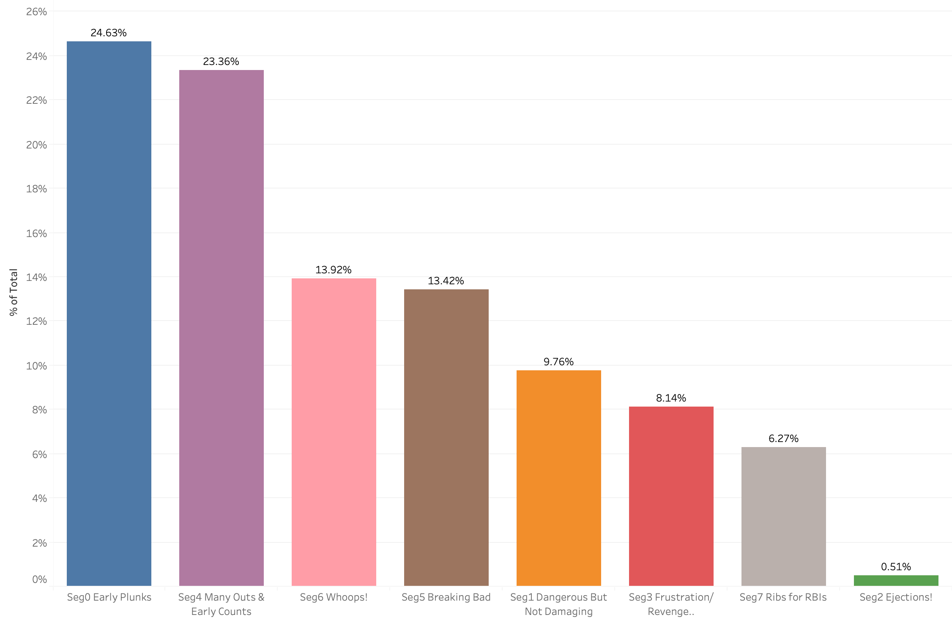
K-prototypes V2 8-cluster solution: High-level overview
Cluster 0 | Cluster 1 | Cluster 2 | Cluster 3
WILD THINGS/ EARLY PLUNKS High base out runs added, high win prob added, average velocity, no baserunners, pit team home, early innings top of lineup, few outs, no risp, low game stat, not a curve | DANGEROUS BUT NOT DAMAGING Higher leverage, high risp, late and close, more outs than average, pitching team ahead, pitching team wins, higher velocity, higher win prob added, low base out runs added, pit. team is away, low number of pitches | EJECTIONS! High game stat (more hbps in game), no runners on , fastball, no strikes in the count, high velocity, pitching team down by many runs, late innings, low leverage, low win prob added, low number of pitches | FRUSTRATION / REVENGE PLUNK High game stat, pitching team behind, down by many runs, late innings, pitcher/batter more likely to be removed, low leverage, low win prob added
Cluster 4 | Cluster 5 | Cluster 6 | Cluster 7
MANY OUTS & EARLY COUNTS High number of outs, high velocity, pitching team home, fastball or sinker, early count, early innings, low base out runs added, low win prob added, low leverage, low number of pitches, not a curveball, low game stat | BREAKING BAD Low velocity, Curve, Knuckler, Slider, no runners on, lefty pitcher, intraleague game, low leverage, low game stat, low win prob added, low number of pitches | WHOOPS! High pitch count, two strikes, higher than average outs, division game, no runners on, low base out runs added, low win prob added, low leverage, low game stat, pitching team is away | RIBS FOR RBIs Highest win prob added, highest base out runs added, highest leverage, bases full, rbi on play, runners in scoring position, pitching team ahead, late and close, higher than average game stat, few outs

Slide 35
Despite the struggles of some models, clear differences do emerge

Slide 36
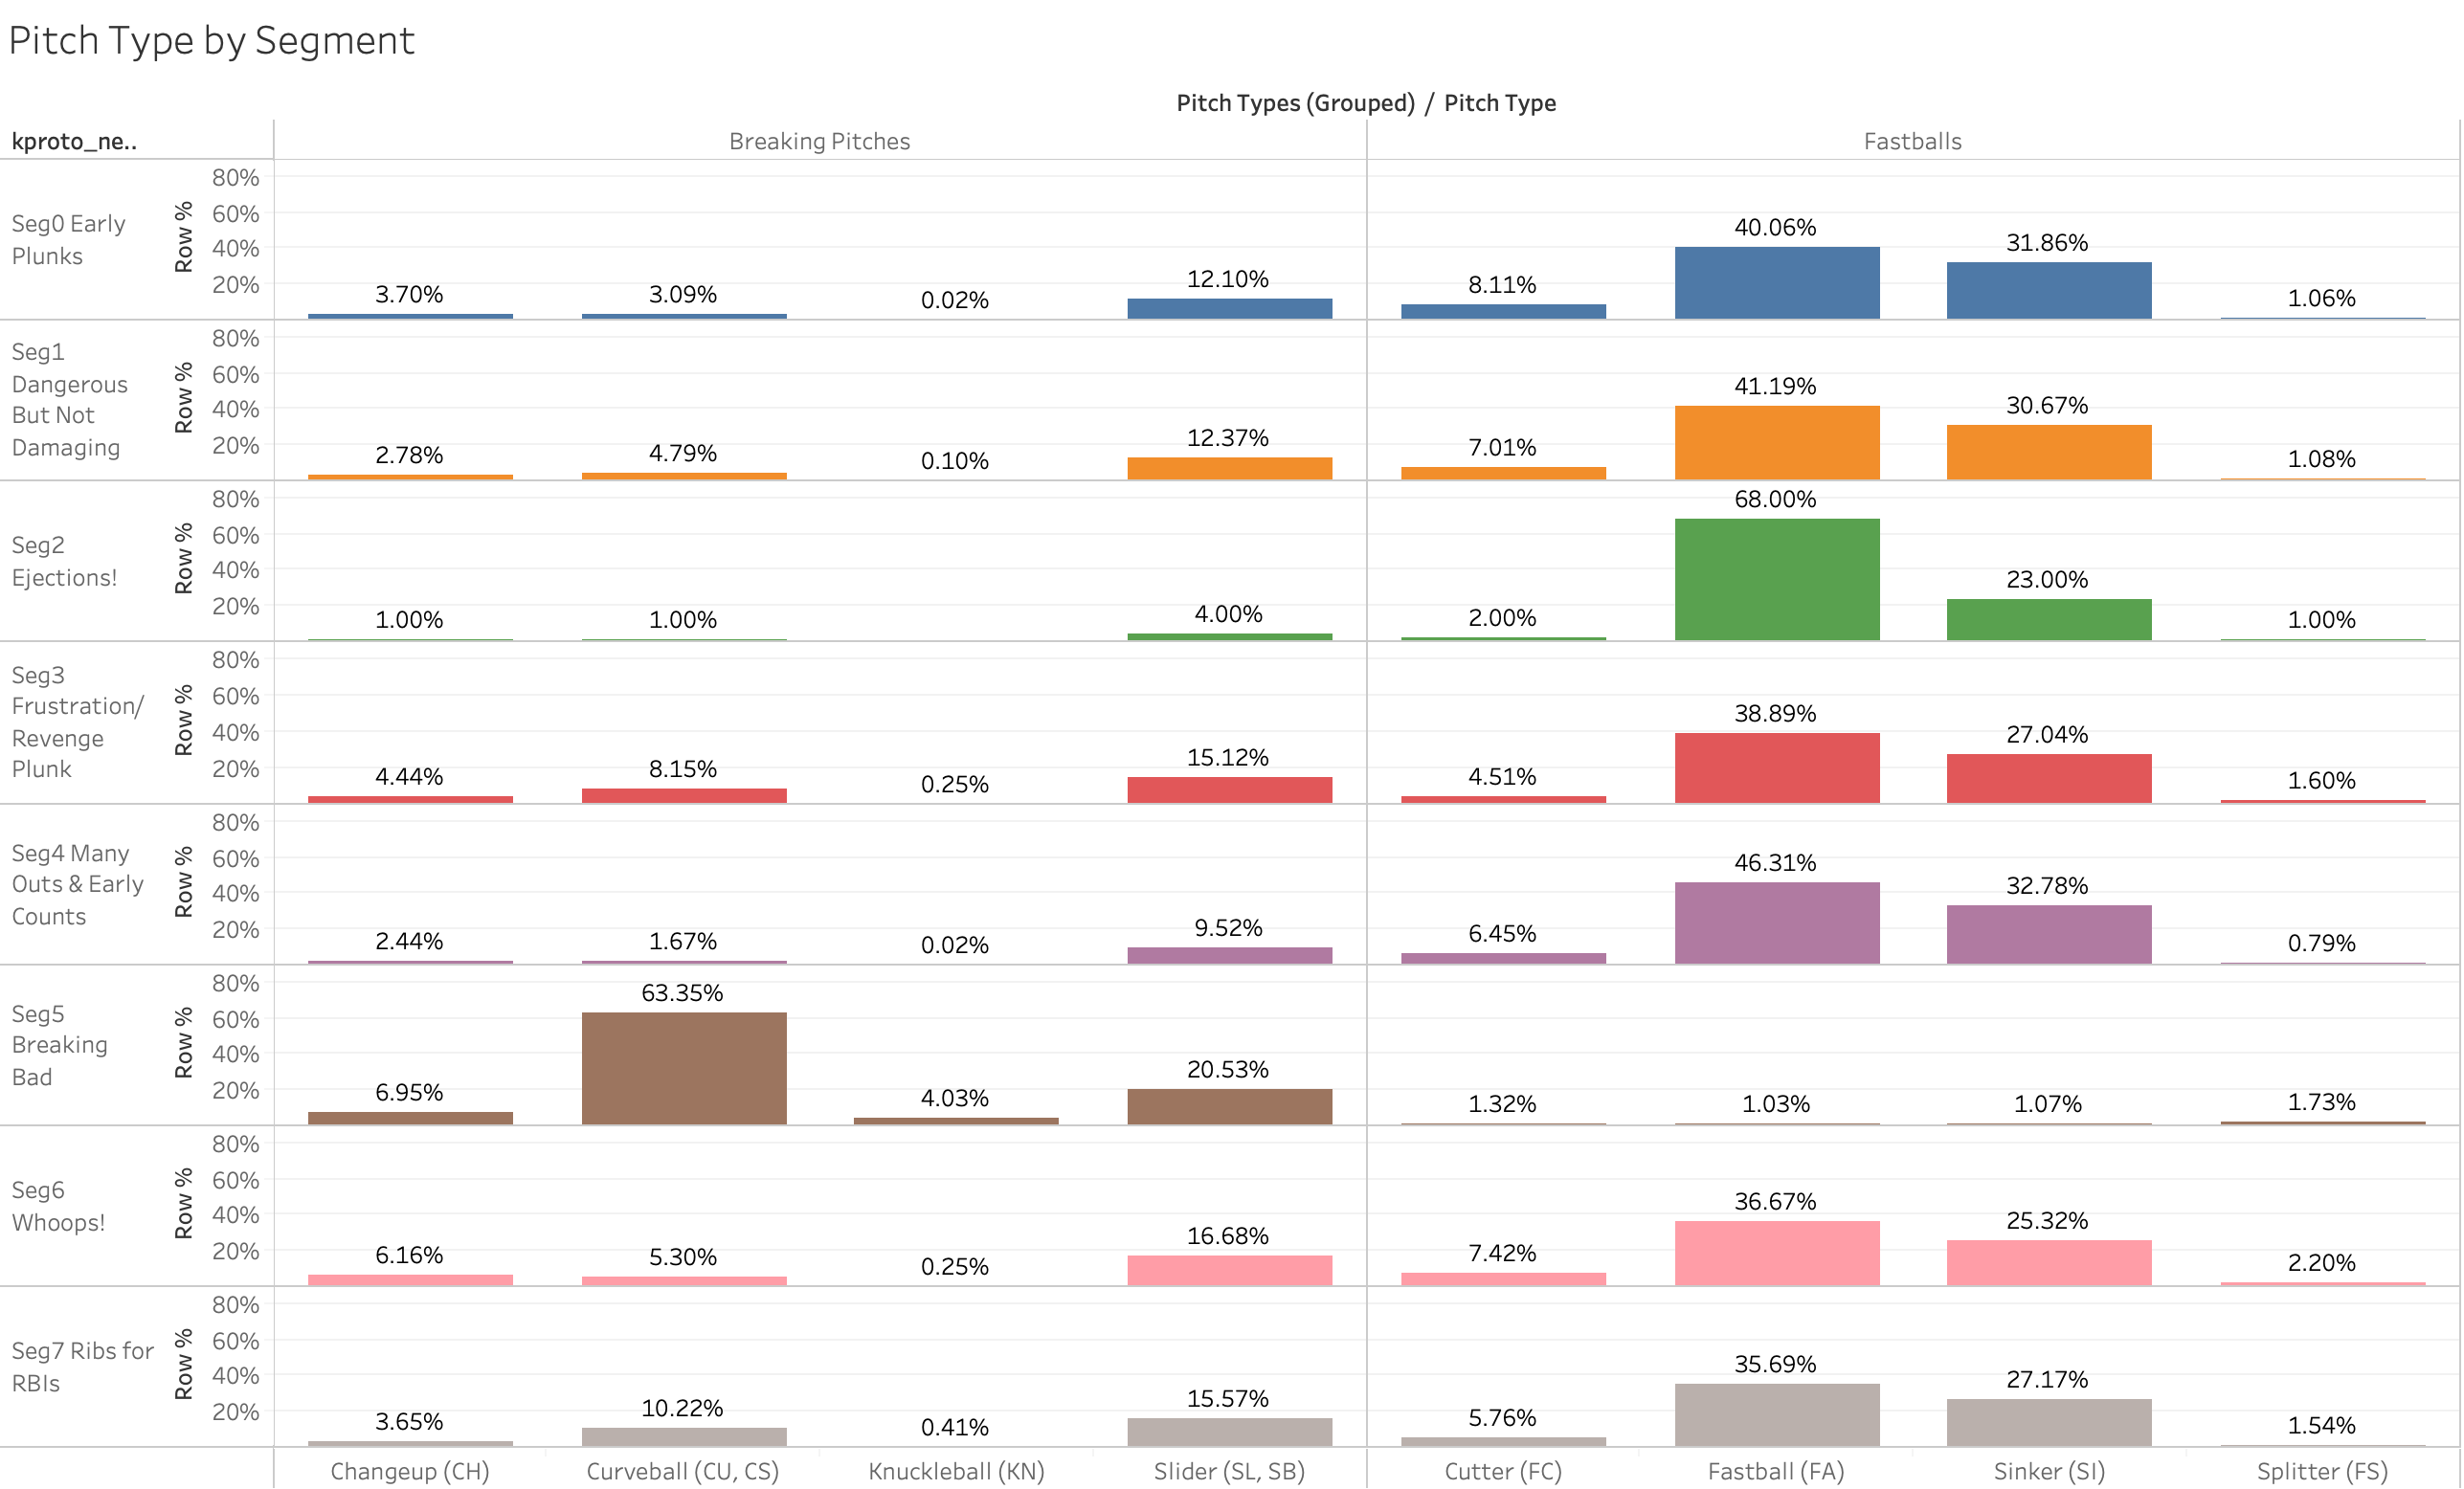
It’s clear wherefrom Breaking Bad gets its name – almost no fastballs

Slide 37
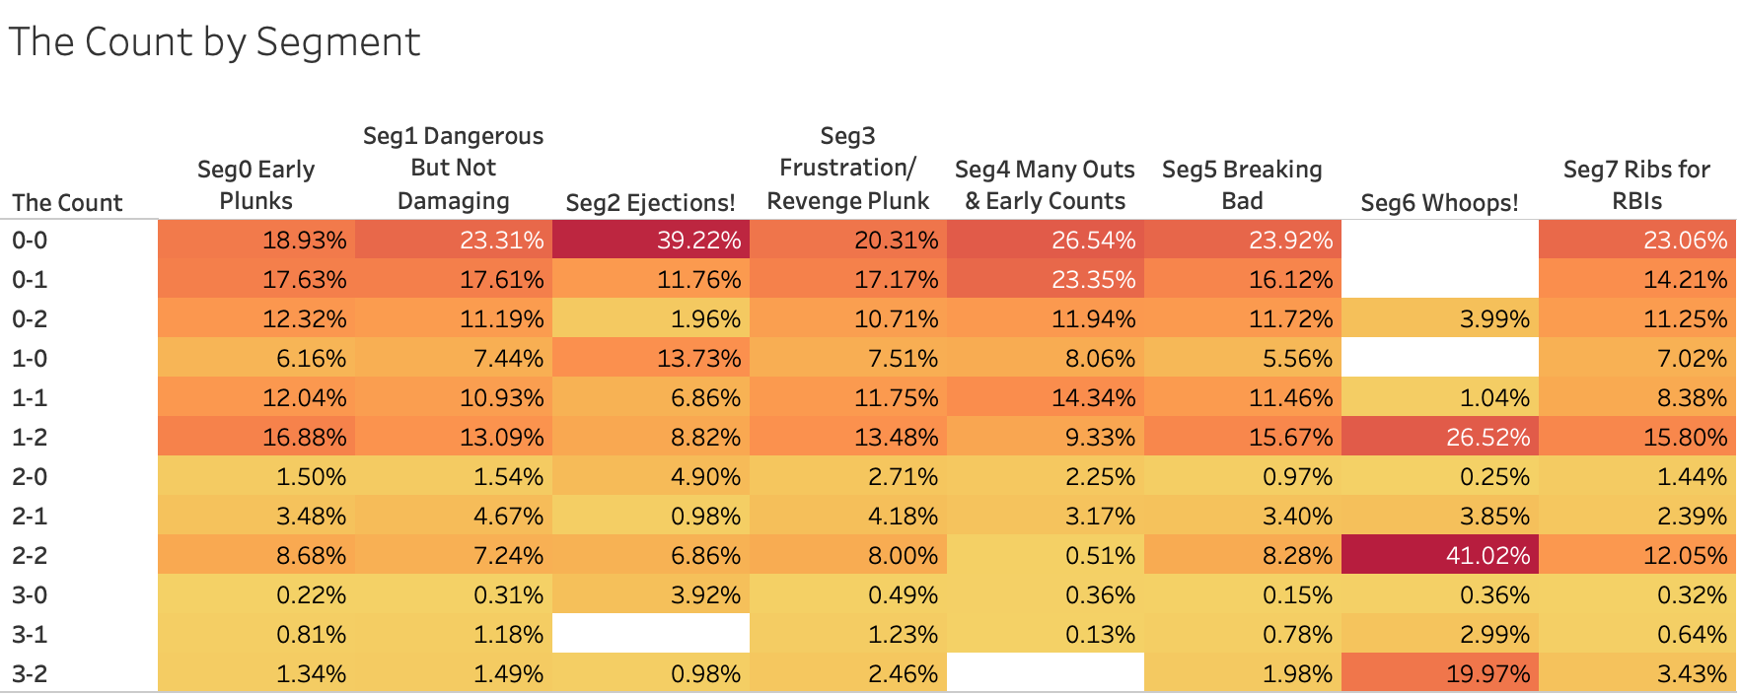
Ejection-worthy HBPs tend to occur early in counts (0-0, 0-1, 1-0), whereas Whoops! HBPs are almost exclusively 2-strike pitches

Slide 38
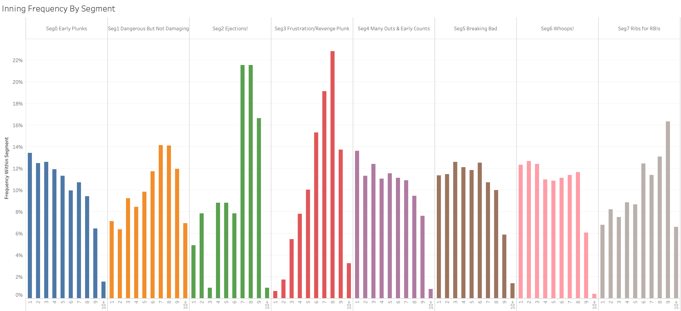
Certain HBP types occur more frequently late than others

Slide 39
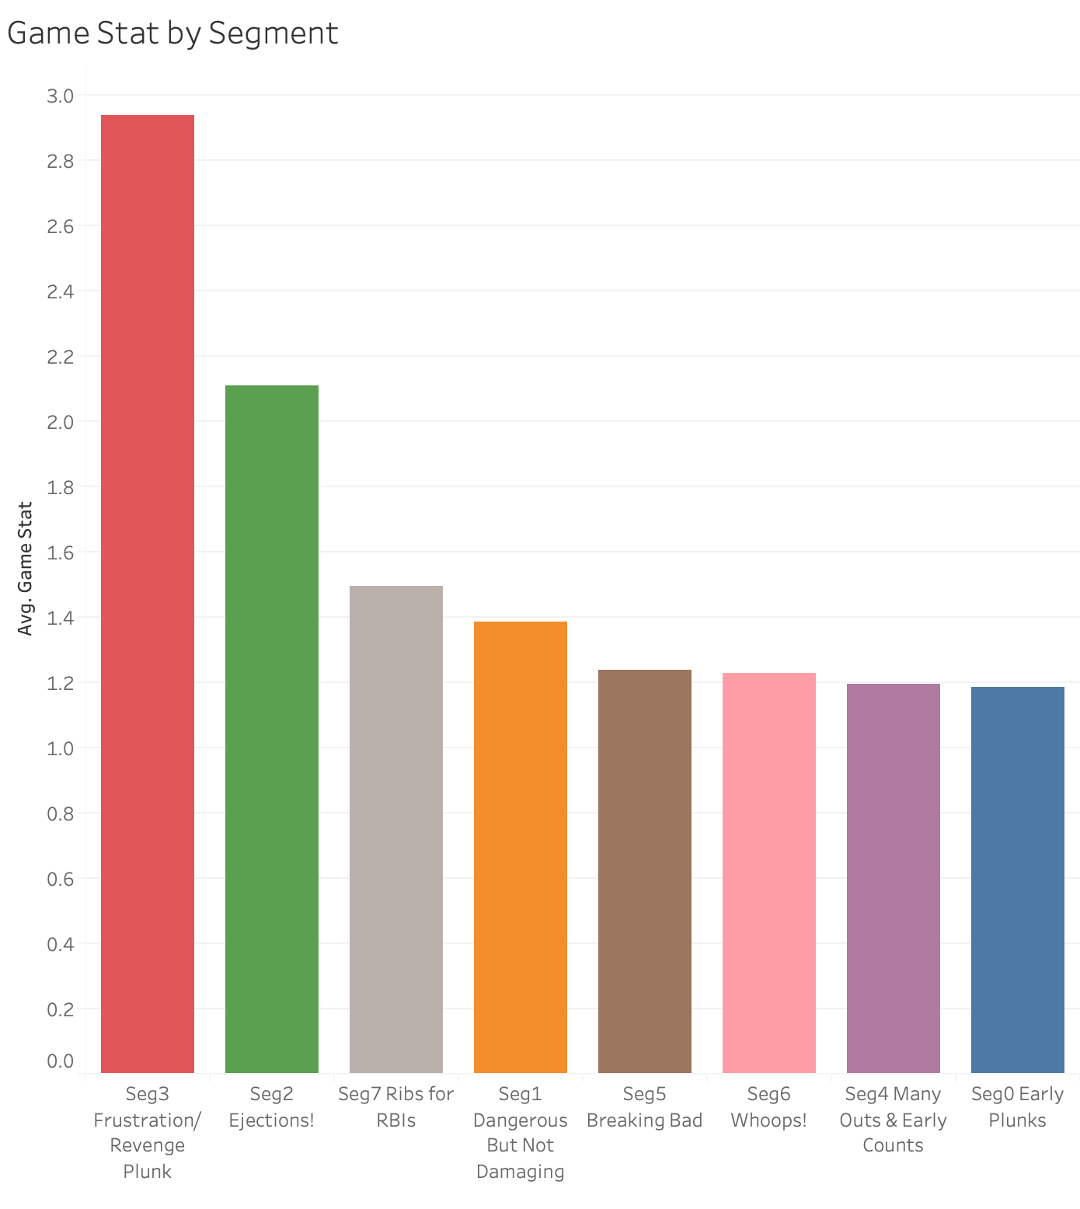
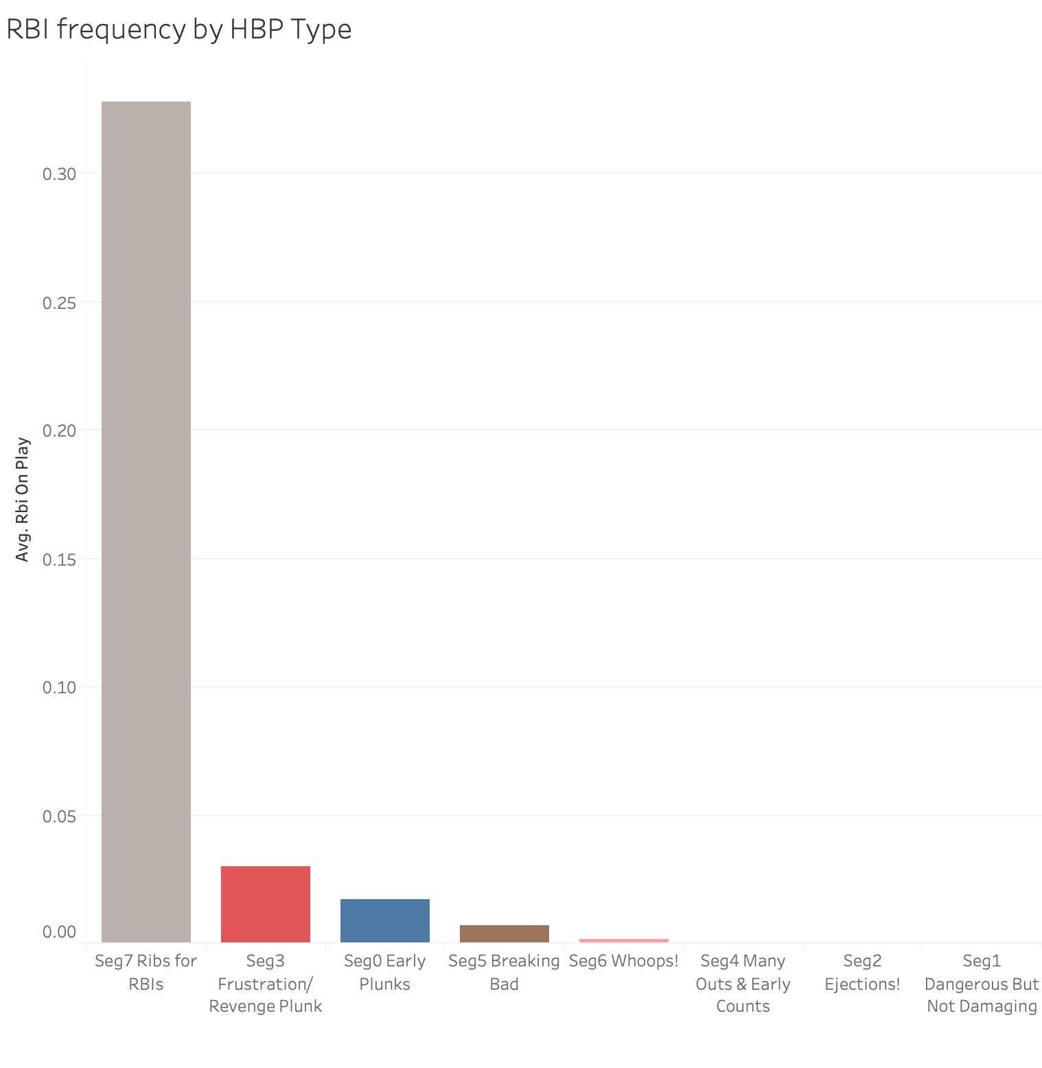
Frustration Plunks and Ejections! tend to occur in game with multiple HBPs; Ribs for RBIs also shows why it gets its name

Slide 40
So we have a typology, now can we build a supervised classifier to predict new or historical events into one of the types uncovered?

Slide 41
Supervised Learning Attempt # 1: Linear Discriminant Analysis
Linear Discriminant Analysis is another dimension reduction technique that is also useful for building classification algorithms; unlike PCA, it is a supervised approach as it requires a categorical dependent variable
LDA tends to be popular in marketing research circles because it’s a relatively straightforward algorithm that is easy for data collection vendors to implement for on-the-fly segment typing
LDA searches for a line (or really a set of lines) that will maximally differentiate between labels/classes while minimizing variance within each class at the same time, then projects the data onto this new axis (or new axes)
Similar to PCA, the first discriminant function explains the most variance in the data; there is one fewer discriminant function than the number of classes in the data
In this case, we are attempting to predict the labels from the V2 K-prototypes 8-cluster solution that we like best; leave-one-out rules were used for categorical predictors
On the whole, the model performs relatively well:
Training data accuracy: 85.39%
Test data accuracy: 84.99%
10-fold cross-validation accuracy: 84.80%
Not much overfitting to speak of, and with 8 segments to predict, the accuracy is fairly high (6.8x random)
Unfortunately, the model only correctly classifies cluster 2 (EJECTIONS!) 50% of the time, when this should be the easiest segment to predict

Slide 42
Supervised Learning Attempt # 2: Xgboost Classifier
Xgboost is a family of gradient boosting machines, offering a supercharged version that outperforms standard gbms implemented in scikit-learn
In addition to improved speed and increased accuracy, Xgboost can also handle missing data, which cannot be said for its scikit-learn counterpart
It’s no wonder Xgboost has been used in many winning Kaggle competition entries
There are many hyperparameters that can be tuned using cross-validation
Like any good gbm, the model benefits from a relatively slow learning rate, and a relatively large number of estimators
My final model used 500 estimators, a max depth of 3, a learning rate of 0.1, and a subsample rate of 0.75
Unsurprisingly (to me anyway), the resulting model’s performance was outstanding:
Training data accuracy: 100%
Test data accuracy: 96.72%
10-fold cross-validation accuracy: 96.52%
While there is some overfitting which I could spend more time trying to reduce, this degree of accuracy is quite acceptable for our purposes
Unlike LDA, all clusters are accurately predicted

Slide 43
Xgboost also provides feature importance scores
There are several scoring options available; the scores to the left are calculated using the “gain” approach – essentially the relative gain in accuracy achieved by the presence of the feature
The top predictor in the model is whether there is any ejection as a result of the HBP, which makes sense since cluster 2 is deterministically defined this way
Other top predictors include how many total hit-by-pitches occurred at this point of the game, the number of outs at the time of the HBP, the RE24 and WPA statistics, the number of pitches thrown, the velocity and the leverage index – mostly continuous measures
However, the second set of 10 predictors includes a number of categorical features such as which team is home, whether the pitch was a curveball, the game being a Division or Intraleague game, and so on

Slide 44
Finally, the Xgboost model was used to predict the missing 287 cases
Since Xgboost can include missing data, the 287 cases from Epoch 3 that were missing velocity data could be classified using this algorithm, with Numpy NaN values in place
FORTUNATELY, the Xgboost classifier works on this data…
… but UNFORTUNATELY, the model appears to still be a bit puzzled to find good surrogates for missing velocities to produce truly nuanced segment assignments
86.7% of these cases get classified into Cluster 5 (BREAKING BAD), which is the HBP type that tends to have the lowest velocity of pitches thrown, with lots of breaking pitches
The remaining clusters assigned include:
Cluster 7 (RIBS FOR RBIs) – 7.0%
Cluster 1 (DANGEROUS BUT NOT DAMAGING) – 2.8%
Cluster 3 (FRUSTRATION/REVENGE PLUNK) – 1.7%
Cluster 6 (WHOOPS!) – 1.0%
Cluster 2 (EJECTIONS!) – 0.7%
None of these cases were classified into Clusters 0 (EARLY PLUNKS) or 4 (MANY OUTS & EARLY COUNTS)
So, the jury is still out for whether this solution will work sufficiently for typing earlier, non-PITCHf/x epochs of the HBP data; it should work great moving forward for any 2020 or later HBP events, though

Slide 45

Next steps
Besides getting some sleep…
This Photo by Unknown Author is licensed under CC BY-SA

Slide 46
A lot of work is left to be done, including:
“Typing” the data from Epochs 1 & 2
This can be accomplished in potentially two different ways:
Use the existing Xgboost classification algorithm to classify Epochs 1 & 2 using the typology built from Epoch 3 data
As explained earlier, Xgboost can handle missing data, but the resulting segment sizes may be distorted, especially for Epoch 1 which is missing the most data
Continue using a pattern sub-model method, where a unique typology is created for each Epoch individually, using unsupervised learning
Resulting segments/types can be compared across eras to see whether any overlaps exist
Another approach could include continuing to work with the Epoch 3 data, but refining the k-prototypes algorithm to skew towards relying more on the categorical/binary data for uncovering HBP types so that historical classifications might work a little better
The 287 cases with missing data from Epoch 3 might actually fit better with Epoch 2 data, which shares the same pattern of missingness, so that could be another consideration
Continue to refine Xgboost model to reduce remaining overfitting and/or produce a more compact model
Build a Flask app to score new (or historical) data into one of the types from this report or from further analysis above
Lots and lots of additional visualizations could also be created – there’s so much data to play with here!
Write blog posts to share progress/findings

Slide 47
Thank you

